Slide 1

Career and Technical Education
Preparing
for the WorkKeys
Assessments
Test-Taking Strategies

Slide 2
Getting Ready
Prepare all year long
Include information in the course syllabus
Instruct students in good test taking habits
Offer practice questions throughout the year
Consider the purchase of the WorkKeys Prep Package as a resource http://www.act.org/workkeys/practice/

Slide 3
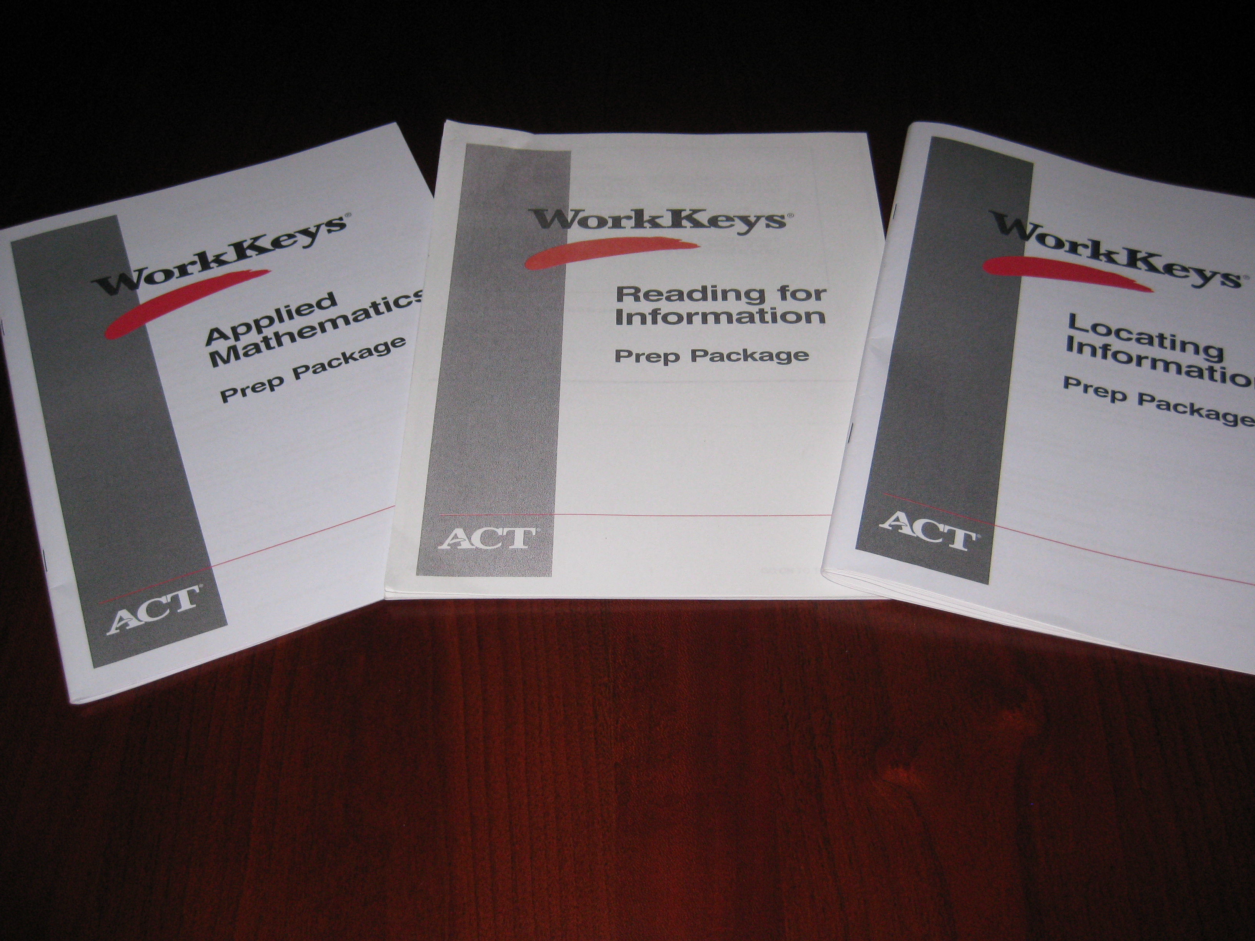

Slide 4
WorkKeys Prep Package
Applied Mathematics, Reading for Information, and Locating Information
$5 for each prep package
Each package includes
  Test Taking Tips
  Answer Sheet
  Test Description
  Practice Test
  Answer Key
  Applied Mathematics contains a Formula Sheet

Slide 5
Test Taking Tips
Pace yourself
Listen to and read the directions for each test carefully
Read each question carefully
Answer the easy questions first
Use logic in more difficult questions

Slide 6
Use logic in more difficult questions.

Slide 7
Test Taking Tips
Answer every question
Review your work
Be precise in marking your answer document
Erase completely

Slide 8
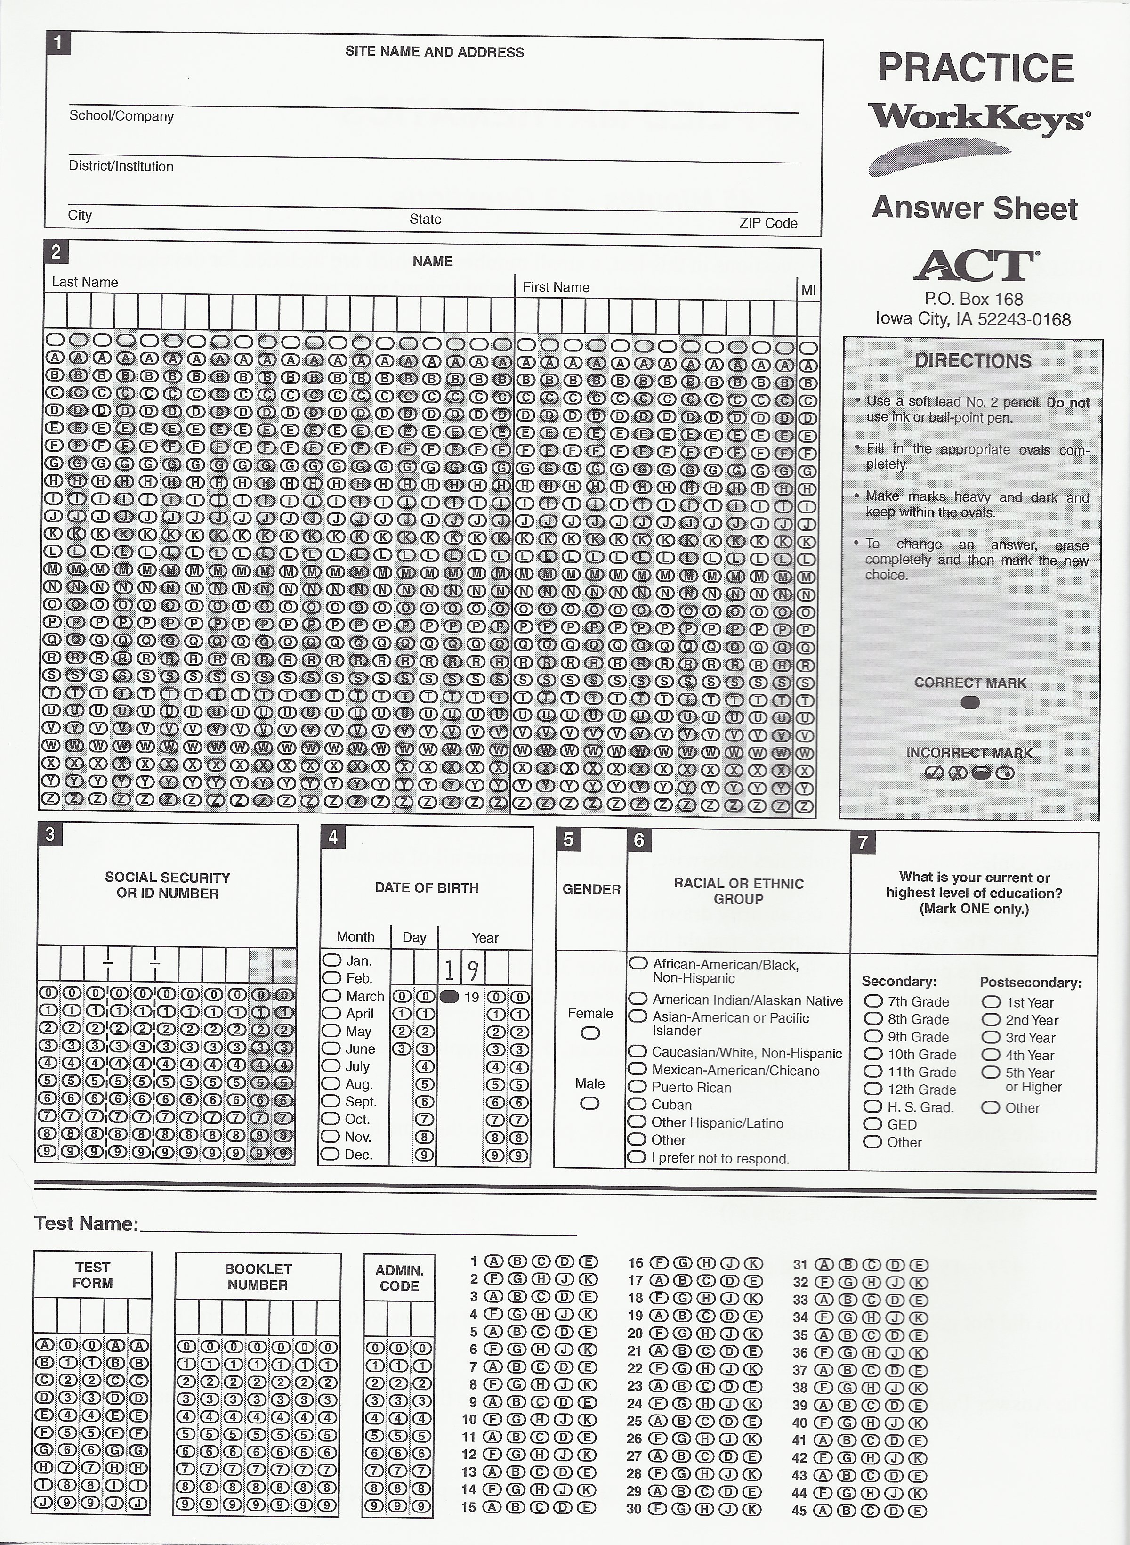

Slide 9
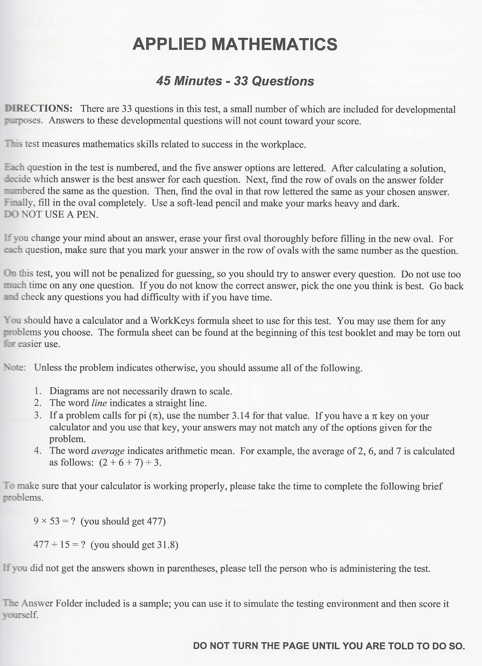

Slide 10
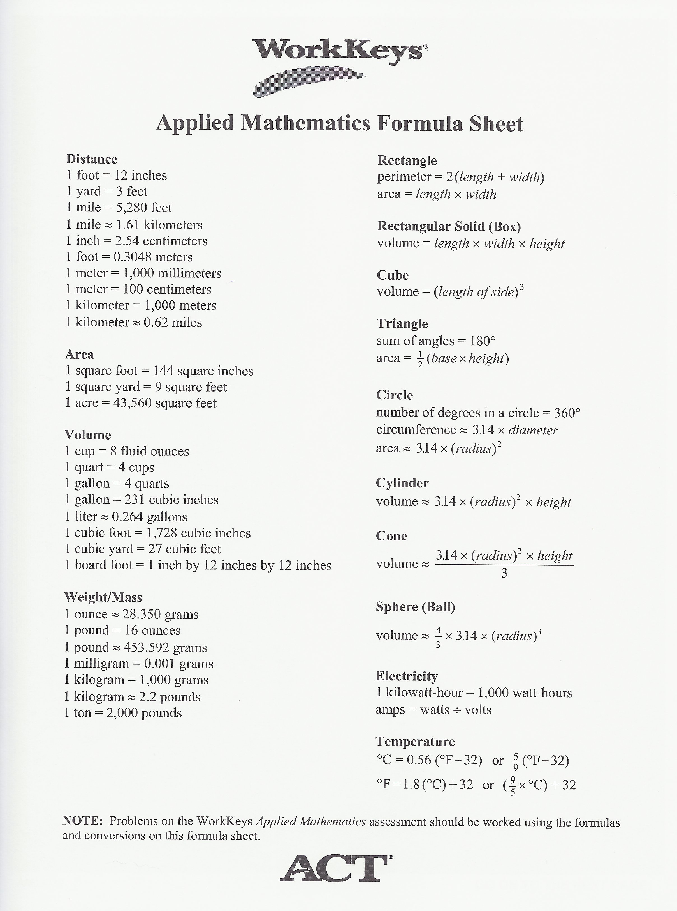

Slide 11
Classroom Activities
Develop WorkKeys like questions as bell ringers and test questions
Review current exams and modify questions to provide practice
Provide practice in the classroom
  Inventory supplies
  Purchasing supplies and equipment
  Student organization accounting
  Use newspapers

Slide 12
Other Resources
  http://www.eed.state.ak.us/tls/assessment/WorkKeys/WK_ParentStudent_Brochure.pdf
  - Student and Parent Informational Brochure
  (offers WorkKeys test taking tips)
www.teacherspayteachers.com
  USA Today Presentation on Practice Reading Graphs

Slide 13
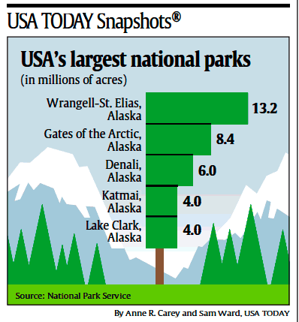
What is the title for this graph?
USA’s largest national parks
What organization provided the information for this graph?
National Park Service
The five largest national parks in the USA are in which state?
Alaska
How much larger is Gates of the Arctic than Delani?
2.4 million acres
Is the Gates of the Arctic park larger or smaller than 15 thousand acres?
larger (8.4 million > 15 thousand)

Slide 14
Other Resources
Similar sample questions (ACT, SAT, COMPASS)
ACT Website www.act.org
  Key Train and Career Ready 101
  WorkKeys Preparing for the WorkKeys Assessment
Contact Office of Career and Technical Education, Angie Fischer at 502-564-3238

