Slide 1

NCCCS Standardized
Pre-Apprenticeship.
Programs. Do we provide:
-Inclusion of RA in Programs?
-Clear Direction to Apprenticeship?
-A Guided Pathway?
-A Simple Mechanism for Adoption?
-A common Port of Departure?
-Perkins Earned Credential/Innovation
-Expanded Opportunities for No/Low skilled Individuals?
-Connect to WIOA?
Notes:
Reference the effect legislation had on dual enrollment programs including Huskins, Learn and Earn Online, and Concurrent Enrollment.

Slide 2
Standardized Pre-Apprenticeship

Slide 3

MC3: Gateway to the Building Trades
A: There are nine sectors or chapters in the MC3:
• Construction Industry Orientation
• Tools and Materials
• Construction Health and Safety
• Blueprint Reading
• Basic Math for Construction
• Heritage of the American Worker
• Diversity in the Construction Industry
• Green Construction
• Financial Literacy

Slide 4
North America’s Building Trades Unions
International Association of Bridge, Structural, Ornamental, and Reinforcing Iron Workers (Iron Workers)
>>International Association of Heat and Frost Insulators and Allied Workers (Insulators)
>>International Brotherhood of Boilermakers, Iron Ship Builders, Blacksmiths, Forgers and Helpers (IBB or Boilermakers)
>>International Brotherhood of Electrical Workers (IBEW)
>>International Brotherhood of Teamsters (Teamsters)
>>International Union of Bricklayers and Allied Craftworkers (BAC or Bricklayers)
>>International Union of Elevator Constructors (IUEC)
>>International Union of Painters and Allied Trades (IUPAT)
>>Laborers’ International Union of North America (LIUNA)
>>Operative Plasterers’ and Cement Masons’ International Association of the United States and Canada (OPCMIA)
>>Sheet Metal Workers’ International Association (SMWIA)
>>United Association of Journeymen and Apprentices of the Plumbing and Pipefitting Industry of the United States and Canada (UA)
>>United Union of Roofers, Waterproofers and Allied Workers (Roofers).

Slide 5
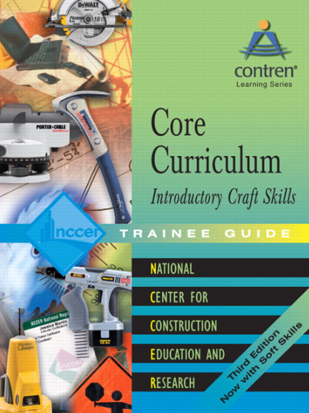
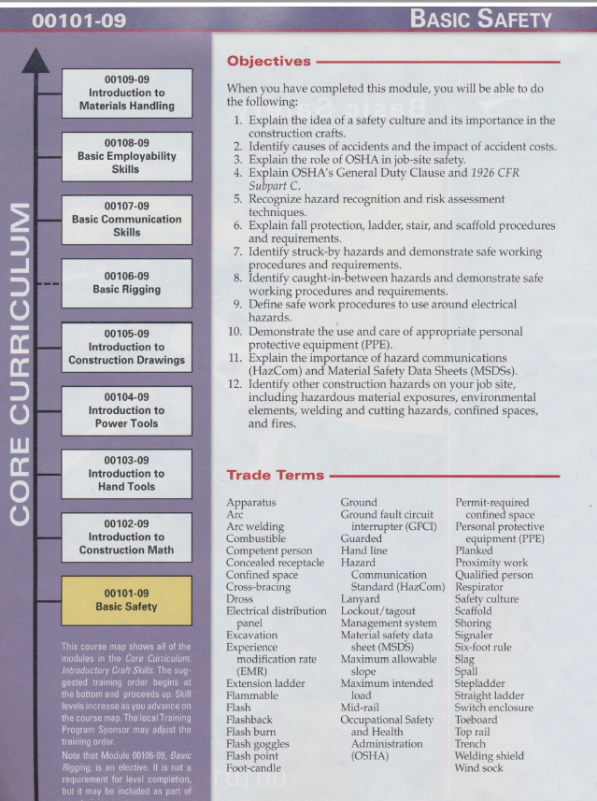
NCCER Construction Core

Slide 7
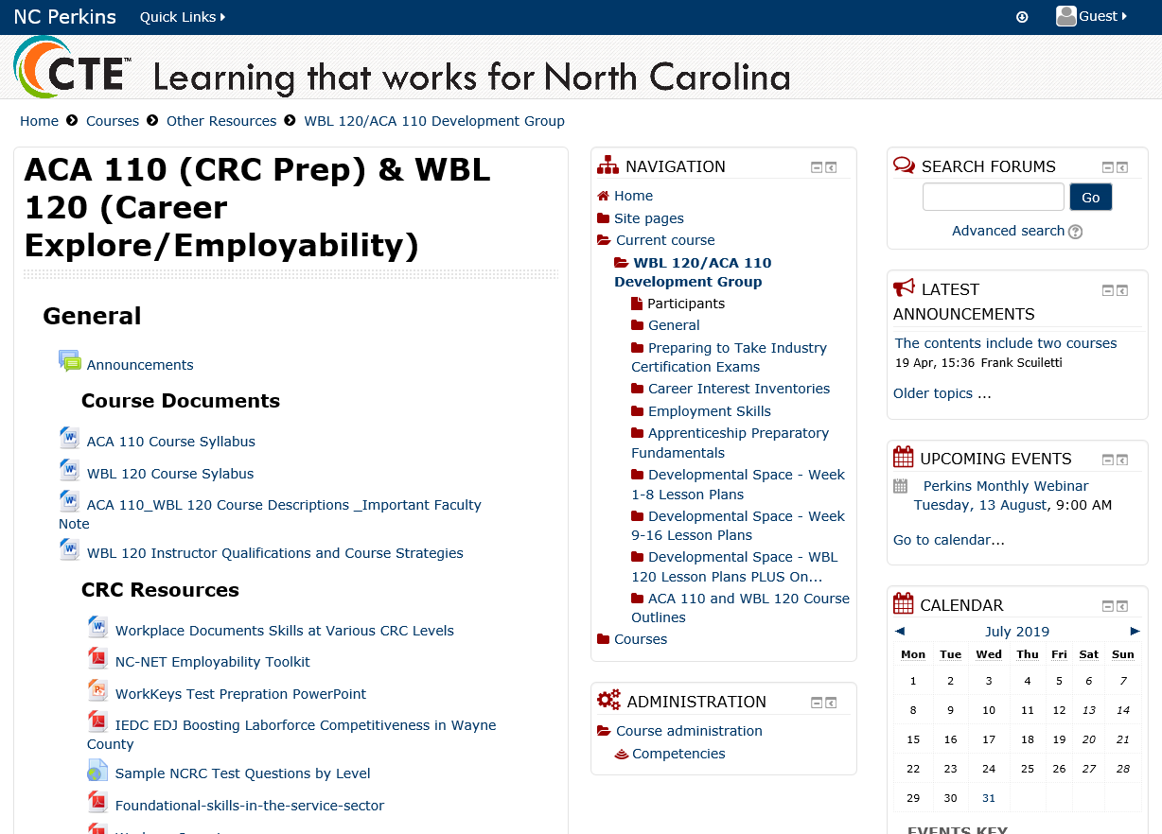
NCPerkins.org
Notes:
Check out resources including syllabus, lesson plans and job sheets.

