Slide 1
Defining and counting
Workforce
Credentials
for
NORTH CAROLINA
Business & industry Feedback sessions
April - May 2020
Notes:
The economy is changing rapidly, and in many cases those changes are happening faster than education systems are able to match. In North Carolina, projections estimate that as many as 50% of the occupations available today will be gone by 2050. But these occupations are not so much disappearing as they are transforming. By 2024, there will be almost 100,000 more new jobs than there will be similar growth in the entire working-age population, with many of those jobs requiring at least some form of higher education experience.

Slide 2
Workforce Credentials
High-quality, non-degree credentials Recognized by employers that help workers obtain in-demand living wage jobs
Notes:
The economy is changing rapidly, and in many cases those changes are happening faster than education systems are able to match. In North Carolina, projections estimate that as many as 50% of the occupations available today will be gone by 2050. But these occupations are not so much disappearing as they are transforming. By 2024, there will be almost 100,000 more new jobs than there will be similar growth in the entire working-age population, with many of those jobs requiring at least some form of higher education experience.

Slide 3
THE PROBLEM in nc
Notes:
myFutureNC is a statewide nonprofit focused on educational attainment and is the result of cross-sector collaboration between North Carolina leaders in education, business and government.

Slide 4
The Problem: 2026 Employment projections
North Carolina is projected to add more than 389,000 new jobs between 2017 and 2026.
Job openings due to separations of existing employees will provide significantly more opportunities for job seekers than openings from new growth.
For each new job created each year, there will be more than 12 vacancies available due to occupational transfers and exits.
Notes:
North Carolina Department of Commerce’s 2018 Employer Needs Survey indicates that half of employers are not able to hire the workers they need. They cite a lack of employability skills (65%), technical skills (49%), and overall education (43%).
These gaps are especially pronounced in the health care, IT, and finance industries.

Slide 5
The Problem: fastest growing jobs require more education
The fastest-growing jobs require a postsecondary degree or nondegree credential. The growth of jobs requiring a nondegree credential or postsecondary degree is projected to outpace total job growth.
Notes:
North Carolina Department of Commerce’s 2018 Employer Needs Survey indicates that half of employers are not able to hire the workers they need. They cite a lack of employability skills (65%), technical skills (49%), and overall education (43%).
These gaps are especially pronounced in the health care, IT, and finance industries.

Slide 6
THE solution for nc
Notes:
Recognizing that no one system or organization can tackle this crisis alone, myFutureNC was created to bring together North Carolina’s thought leaders in education, business, philanthropy, faith-based and non-profit communities, and ex officio representatives from the North Carolina House of Representatives, Senate, and governor’s office. Over the last year, we have conducted research and collected input from experts across the state to develop a vision—from preschool through postsecondary and the workforce—for a stronger and more competitive North Carolina.

Slide 7
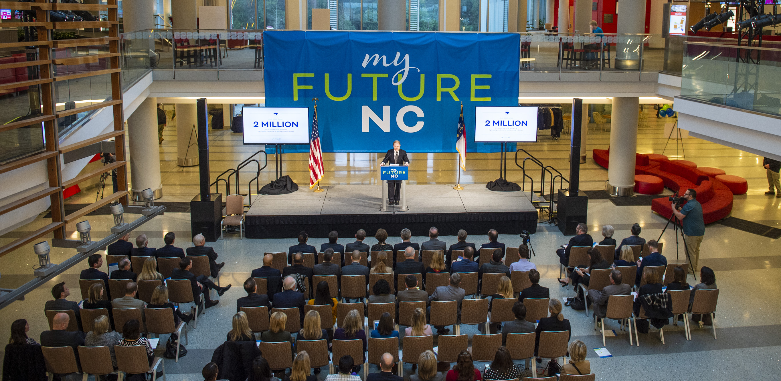
Notes:
myFutureNC began as an idea in January 2017. Education and business leaders were both identifying strategies to increase postsecondary attainment and improve access for students from disadvantaged backgrounds—and solidifying a talent pipeline for years to come.
Together, education, business, and civic leaders became the myFutureNC Commission and launched a statewide conversation about economic competitiveness, workforce development, and educational attainment. For 18 months, myFutureNC has been hard at work convening the right people, determining the right goal, and securing statewide buy-in.
On Feb. 20, 2019, myFutureNC—along with leaders in government, business, and education—declared a bold vision for a future North Carolina, one that is intended to completely close the educational attainment gap: Two million North Carolinians will have a high-quality postsecondary degree or credential by the year 2030.

Slide 8
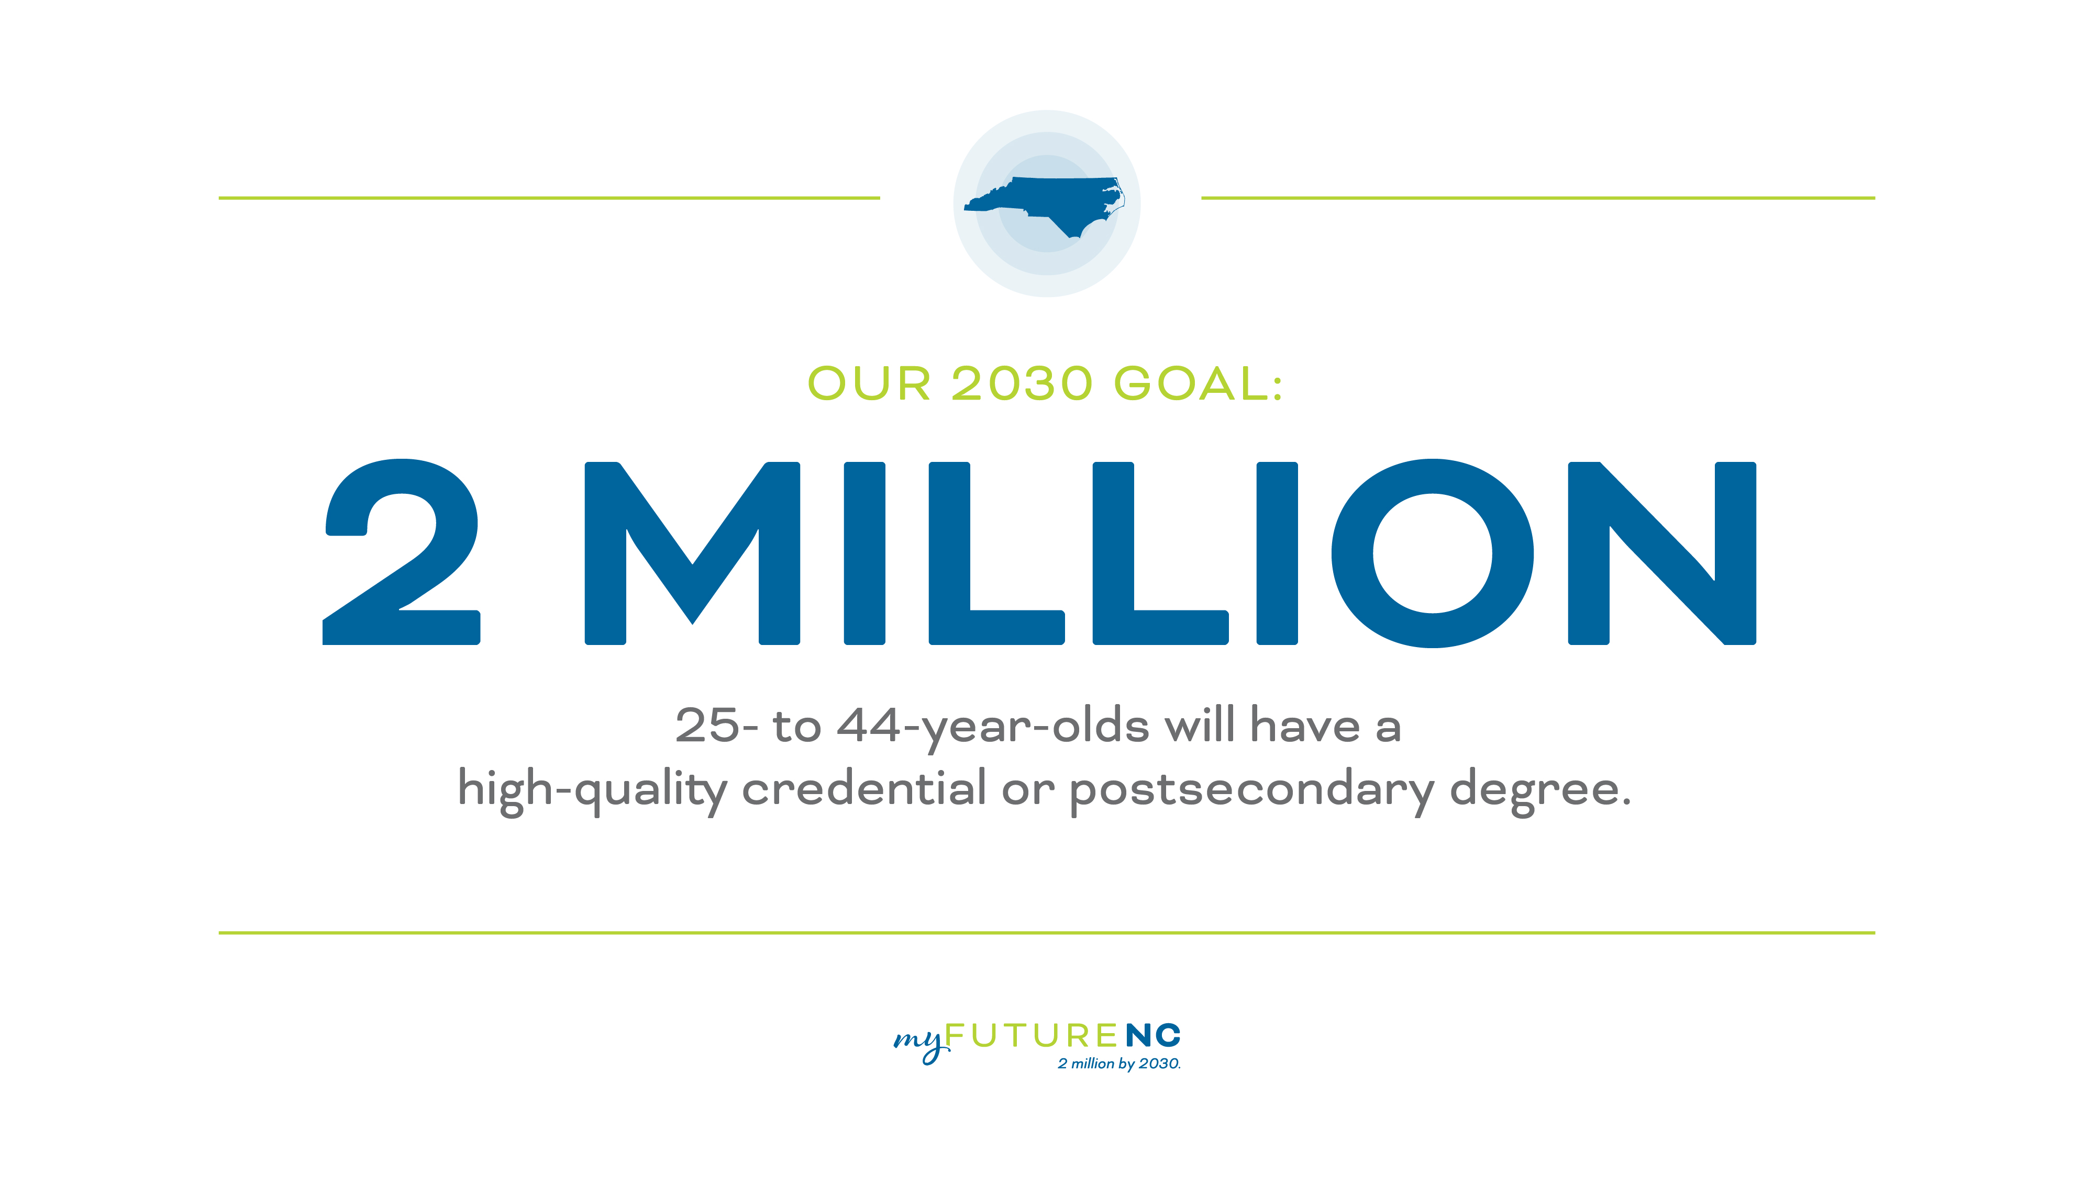
Notes:
As of 2016, about 1.3 million 25- to 44-year-olds had met this goal. Without any changes, North Carolina is projected to have about 1.6 million adults who meet the attainment definition in 2030, which means our state will need to help an estimated 400,000 additional residents attain a high-quality credential or postsecondary degree for our state to meet the demands of our businesses and industries.
myFutureNC has received tremendous statewide support for the goal and is working across sectors and in communities throughout the state to increase career readiness and the quality of educational opportunities for all North Carolinians.
In fact, the cross-sector coalition of education, workforce, and government leaders and organizations is the first of its kind in pushing an education attainment goal forward in North Carolina.
On June 26, 2019, following strong bipartisan leadership from the North Carolina General Assembly, Governor Roy Cooper signed HB664 into law, codifying one of the highest educational attainment targets in the nation. This legislation will help guide policy decisions locally, regionally, and statewide, strengthening efforts to bridge North Carolina’s 400,000-person educational attainment gap.

Slide 9
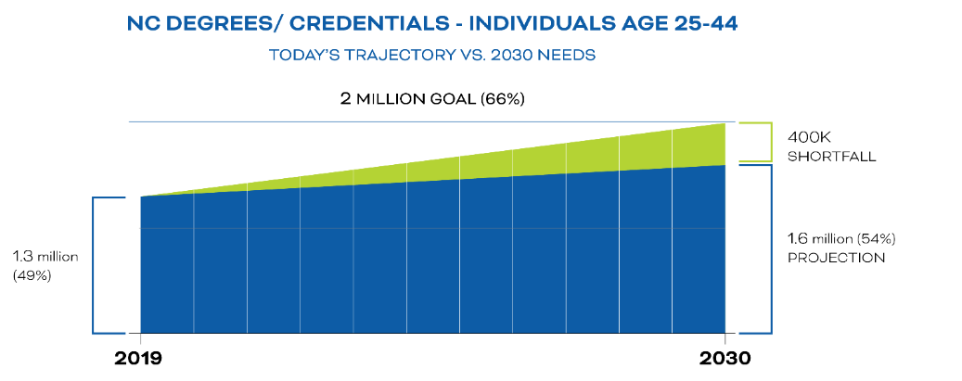
MyFutureNC Goal
2M North Carolinians with high quality credential or post-secondary degree
Determining what counts
NC Workforce Credentials
High-quality, non-degree credentials valued by NC employers that support North Carolinians in obtaining in-demand living wage jobs

Slide 10
DETERMINING WHAT COUNTS
Notes:
Recognizing that no one system or organization can tackle this crisis alone, myFutureNC was created to bring together North Carolina’s thought leaders in education, business, philanthropy, faith-based and non-profit communities, and ex officio representatives from the North Carolina House of Representatives, Senate, and governor’s office. Over the last year, we have conducted research and collected input from experts across the state to develop a vision—from preschool through postsecondary and the workforce—for a stronger and more competitive North Carolina.

Slide 11
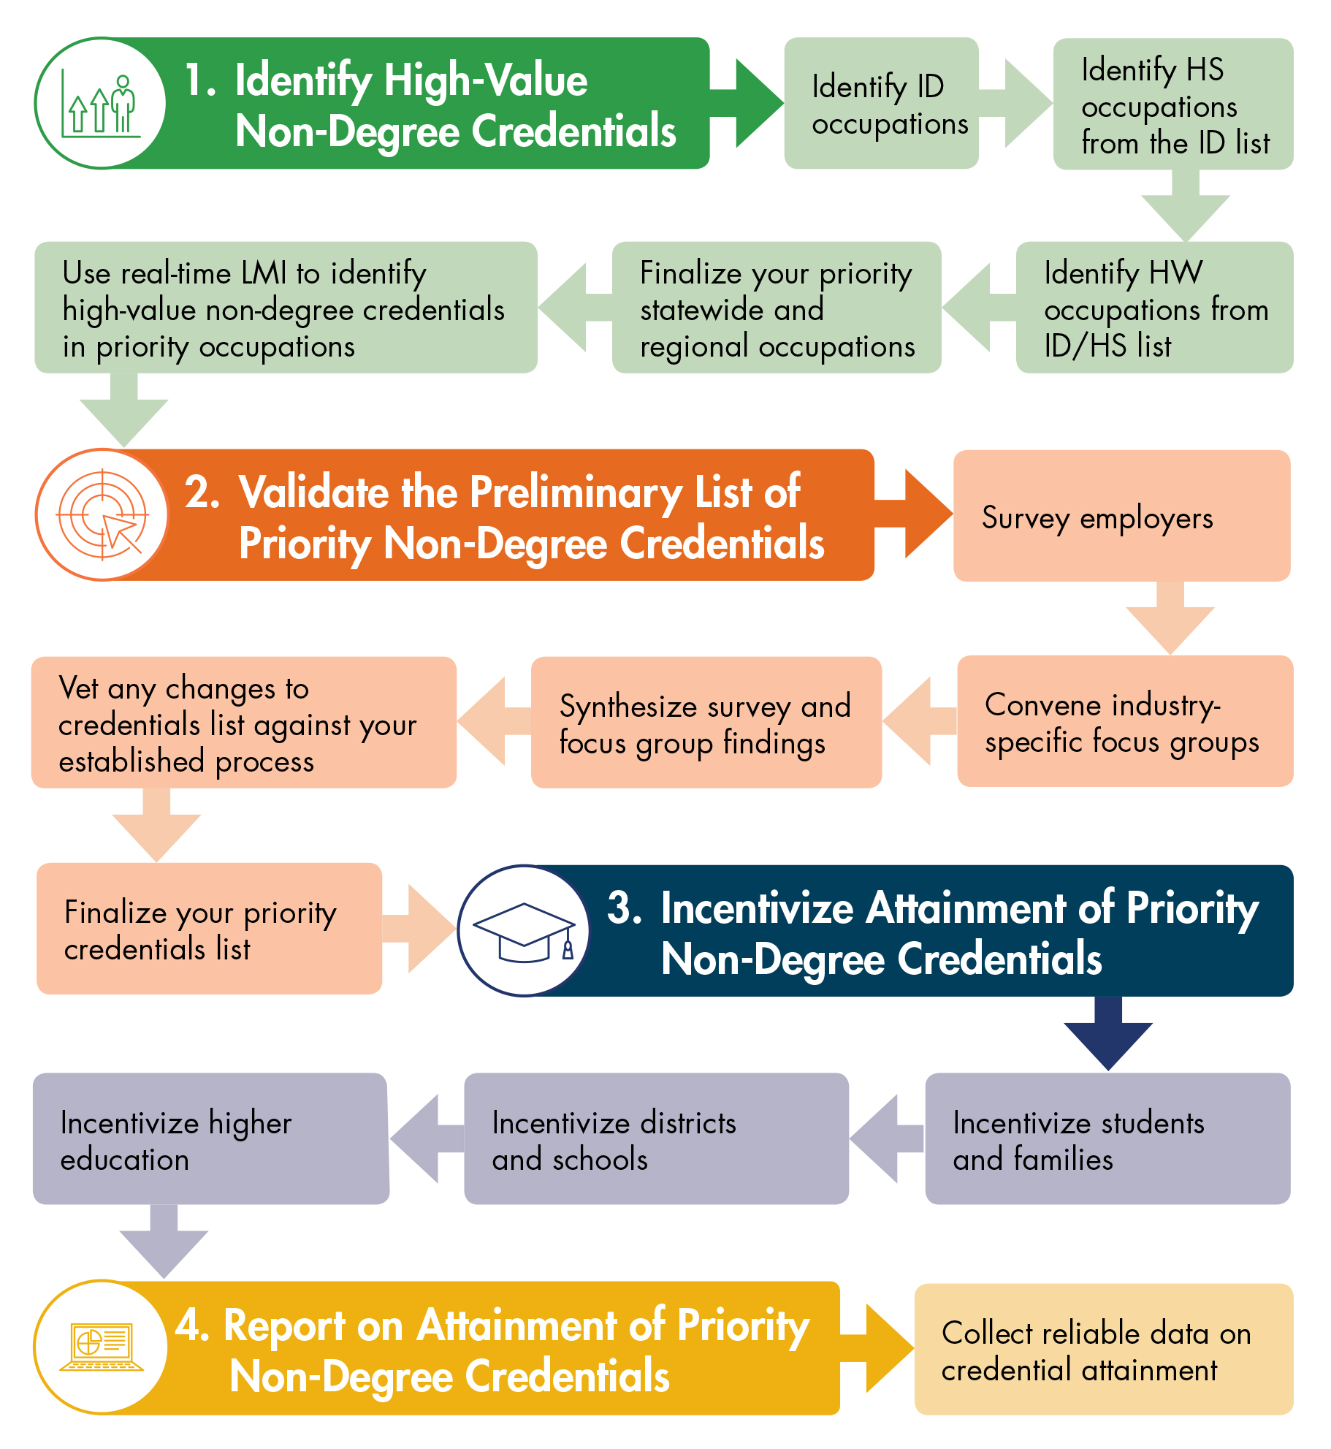

Identify Recognized
NC Workforce Credentials
Building Credential Currency Toolkit: What’s Inside
Building Credential Currency Toolkit offers cross-sector teams a suite of resources to identify, validate, incentivize, and report on their state’s priority non-degree credentials.

Slide 12






















NC COV
Initial NC Cross-Sector Partners

Slide 13
NC Workforce Credentials
Determining what counts
NC Workforce Credentials
High-quality non-degree credentials recognized by NC employers that support North Carolinians in obtaining in-demand living wage jobs
High Value
Demand
Wages
Types of Credentials
State Agency
Industry Developed
Workforce Defined
Credential Role
Foundational
Essential
Career
Advanced
Credentials must
Build into our accountability systems
Count toward attainment goals
Embed in career pathways and guided pathways
Signal to learners what has a value to their careers

Slide 14
Non-Degree NC Workforce Recognized Credentials
Types of Credentials
Workforce Sector Credentials Awarded by Education Institution Defined by workforce/advisory boards | Industry Certifications Awarded by a certification body Demonstration of knowledge, skills and abilities to perform specific skills
Pre-Apprenticeship/Registered Apprenticeship Earned through ‘Earn and Learn’ models | State Certifications Awarded by a government agency Demonstration of pre-determined knowledge, skills and abilities

Slide 15
Credential Categories
Foundational Credentials
Credentials Demonstrating Standard or Baseline Skillsets
Essential Credentials
Examples: Nurse Aide I, Pharmacy Technician, Construction Labor
Career Credentials
Examples: CDL, Law Enforcement, Lineworker, HVAC Technicians
Examples:
First Aid, Soft Skills, Notary, MS Office Applications
Credentials with Pathways Leading to Sustainable Wage Careers
Credentials Supporting Sustainable Wage Careers
Advanced Credentials
Credentials Supporting Career Development
Examples: Marine Welding, Certified Cisco Network Professional, Computed Tomography
General Skill Proficiency
Workforce Recognized Credentials

Slide 16
NC STAR JOBS
Stars |  | Characteristics
5 | Best | Growing (rate and openings) jobs that have above median wages
4 | Very Good | Growing jobs that generally have at least median wages
3 | Good | Generally above average in at least 2 of the 3 criteria
2 | Fair | Generally low wage or low growth (rate and openings)
1 | Poor | Typically, low wage and low growth (rate and openings)
Wages: based on the 2018 Occupational Employment Statistics (OES) data release
Openings: number of projected openings due to growth, transfers, and exits between 2017 - 2026
  Growth Rate: number of projected employment relative to the number of 2017 employment

Slide 17
Aligning STAR Jobs and Credential Categories
 | 2✩ Openings | 3✩ Openings | 4✩ Openings | 5✩ Openings
5✩ Wage
4✩ Wage
3✩ Wage
2✩ Wage
1✩ Wage
Career and Advanced Credentials
Essential Credentials

Slide 18
EXAMPLES OF ALIGNMENT:
OCCUPATIONS WITH Career and Essential Credentials
Notes:
Recognizing that no one system or organization can tackle this crisis alone, myFutureNC was created to bring together North Carolina’s thought leaders in education, business, philanthropy, faith-based and non-profit communities, and ex officio representatives from the North Carolina House of Representatives, Senate, and governor’s office. Over the last year, we have conducted research and collected input from experts across the state to develop a vision—from preschool through postsecondary and the workforce—for a stronger and more competitive North Carolina.

Slide 19
Career Credentials: 5 STAR (WAGE) Jobs
Occupation Title | Wage Rating | Job Opening Rating | Non-degree Post Secondary Credential/Workforce Training
Commercial Pilots | 5 | 3 | Pilot License
Electrical and Electronics Repairers, Powerhouse, Substation, and Relay | 5 | 3 | Substation and Relay Technician
Power Plant Operators | 5 | 3 | Power Plant Operator
Transportation, Storage, and Distribution Managers | 5 | 3 | Distribution Manager Certification

Slide 20
Career Credentials: 4 STAR (WAGE) Jobs
Occupation Title | Wage Rating | Job Opening Rating | Non-degree Post Secondary Credential/Workforce Training
Aircraft Mechanics and Service Technicians | 4 | 4 | Assembly Maintenance Certification
Claims Adjusters, Examiners, and Investigators | 4 | 5 | Claims Adjuster
Construction and Building Inspectors | 4 | 4 | Inspectors
Electrical and Electronics Repairers, Commercial and Industrial Equipment | 4 | 4 | ISA Certified Control Systems Tech Level I
Electrical Power-Line Installers and Repairers | 4 | 4 | Lineworker
First-Line Supervisors of Construction Trades and Extraction Workers | 4 | 5 | Project Supervision
Riggers | 4 | 2 | Rigger and Signal Certification

Slide 21
Career Credentials: 3 STAR (WAGE) Jobs
Occupation Title | Wage Rating | Job Opening Rating | Non-degree Post Secondary Credential/Workforce Training
Automotive Body and Related Repairers | 3 | 4 | Collision Repair Technician
Automotive Service Technicians and Mechanics | 3 | 5 | Automotive Maintenance & Light Repair
Bus and Truck Mechanics and Diesel Engine Specialists | 3 | 5 | Diesel Engine Specialist
Dental Assistants | 3 | 5 | Certified Dental Assistant
Dental Laboratory Technicians | 3 | 3 | Dental Laboratory Technician
Electricians | 3 | 5 | Electrical Certification
Heating, Air Conditioning, and Refrigeration Mechanics and Installers | 3 | 5 | HVAC Technician
Heavy and Tractor-Trailer Truck Drivers | 3 | 5 | CDL - Class A

Slide 22
Essential Credentials:
2 STAR (WAGE) Jobs
Occupation Title | Wage Rating | Job Opening Rating | Non-degree Post Secondary Credential/Workforce Training | Pathway
Carpenters | 2 | 5 | Carpentry | Skilled Trades
Drywall and Ceiling Tile Installers | 2 | 3 | Drywall | Skilled Trades
Emergency Medical Technicians and Paramedics | 2 | 5 | EMT | Healthcare Occupations
Excavating and Loading Machine and Dragline Operators | 2 | 3 | Heavy Equipment | Skilled Trades
Highway Maintenance Workers | 2 | 4 | Highway Construction Trades | Skilled Trades
Industrial Truck and Tractor Operators | 2 | 5 | CDL - Class B | Logistics / TOMS
Medical Assistants | 2 | 5 | Medical Assistant | Healthcare Occupations
Pharmacy Technicians | 2 | 5 | Pharmacy Technician | Healthcare Occupations
Phlebotomists | 2 | 5 | Phlebotomist | Healthcare Occupations
Sheet Metal Workers | 2 | 4 | Sheetmetal Worker | Skilled Trades

Slide 23
Essential Credentials:
1 STAR (WAGE) Jobs
Occupation Title | Wage Rating | Job Opening Rating | Non-degree Post Secondary Credential/Workforce Training | Pathway
Cabinetmakers and Bench Carpenters | 1 | 4 | Cabinetmaking | Skilled Trades
Childcare Workers | 1 | 5 | Childcare attendant | Childcare Teacher
Construction Laborers | 1 | 5 | Multiple | Skilled Trades
Home Health Aides | 1 | 5 | Home Health Aide | Healthcare Occupations
Light Truck or Delivery Services Drivers | 1 | 5 | CDL - Class C | Logistics / TOMS
Nursing Assistants | 1 | 5 | Nurse Aide I | Healthcare Occupations
Personal Care Aides | 1 | 5 | Personal Care Aides | Healthcare Occupations
Tire Repairers and Changers | 1 | 4 | Certified Tire Installation Technician | Automotive Technician

Slide 24



Workforce Continuing Education
Skills needed for NC workforce demand
Training for the jobs needed today
Structure to support training for today’s job into education for tomorrow’s career
Right course
Right time
Right path

Slide 25

Create Pathways and Accelerate Attainment: Credit for Prior Learning
CE to CU Articulation
Credit for Credentials
Military Credit
Apprenticeships
Exams
Portfolios
HS to CU Articulation
Right course
Right time
Right path

Slide 26
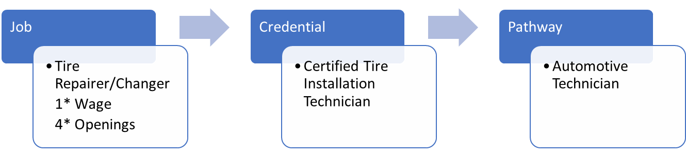
WCE Workforce Credential
Leads to Identified Workforce Credential
  Starting Point Credential
    Requires pathway to career credential
  Career Credential
  Boosting Credential
Supports Credit for Prior Learning
Measure for myFutureNC
  Potential for Performance Funding
Pathway Example
Notes:
Need a structure for on-going assessment
Leverage WDLC
Leverage CCRC for CPL
Need to define successful completion
Beginning work with RPM on grade definitions in WCE

Slide 27
Next steps for
NC Workforce Recognized Credentials
Notes:
Recognizing that no one system or organization can tackle this crisis alone, myFutureNC was created to bring together North Carolina’s thought leaders in education, business, philanthropy, faith-based and non-profit communities, and ex officio representatives from the North Carolina House of Representatives, Senate, and governor’s office. Over the last year, we have conducted research and collected input from experts across the state to develop a vision—from preschool through postsecondary and the workforce—for a stronger and more competitive North Carolina.

Slide 28
Timeline
May
June
Review best policy practices in other states, explore and define incentives, consider policy levers at every level, develop a legislative strategy
July
Compiles and refines recommendations from data analysis, input from employers and policy review
Aug
Submits NC COV proposal for presentation to myFutureNC Board of Directors and sector governing bodies
Analyze survey data and summarize results
Collect targeted input and validation from employers

Slide 29
@myFutureNC
#2millionby2030

Slide 30
Thank you
Notes:
Making this bold attainment goal a reality would be impossible without the help of stakeholders across the state like yourselves. Here’s how you and your organization can get involved.

