Slide 1
Short Term Workforce RFP
Business Solution

Slide 2
Short-Term Workforce RFP
The purpose of this RFP is to solicit offers for a high productivity application solution to meet the ongoing and dynamic Short-Term Workforce Development business needs of the NCCCS.
  Serve NCCCS students, faculty, staff, and industry partners​
  Centralized implementation, operations, maintenance, and support ​
  All 58 community colleges and the System Office
Short Term Workforce Development programs provide training and instruction to meet the needs of individuals seeking to gain new or to upgrade job-related skills and employers who require a skilled labor force. Training programs are dynamic and require responsive delivery from technology to meet course and student needs.

Slide 3
Short Term Workforce Development RFP Consensus Evaluation Team
Basic Skills
Corporate Training
Customized Training
Finance
Human Resources
Information Technology
Internal Auditor
Occupational Extension
Public Safety
Registrar
Senior CE Administrator
Small Business Center
Subject Matter Experts Areas of Representation

Slide 4
Short Term Workforce Development RFP Consensus Evaluation Team
Legal Affairs
Cheryl Kaminski
Brian Leonard
Procurement
Sharon Rosado
Lisa Cobb
ERP PMO
Patrick Fleming
Salman Kidwai
Janet Worthington
Programs
Margaret Roberton
System Office Resources

Slide 5
Short-Term Workforce – RFP
Milestones
Action | Date
Issue of RFP | April 10
Pre-Bid Conference | April 23
Vendor Questions and Responses | May - June
Submission of Offers | June 28
Offer Analysis - Substantial Conformity to RFP Evaluation Criteria | July – September
Enterprise Resource Planning Executive Steering Committee Consensus on Finalists​ | October 2
Product Demonstration by Finalists | October 2019 – February 2020
Negotiations | February 2020
Recommendation to Award | March 2020
Contract Award | Spring 2020

Slide 6

STWF Vendor
Until the Contract to Award process is complete the vendor decision remains under the rules of procurement.
*State Board of Community Colleges, Office of State Budget and Management, DIT Legal, & Statewide IT Procurement.
It is not currently public knowledge

Slide 7
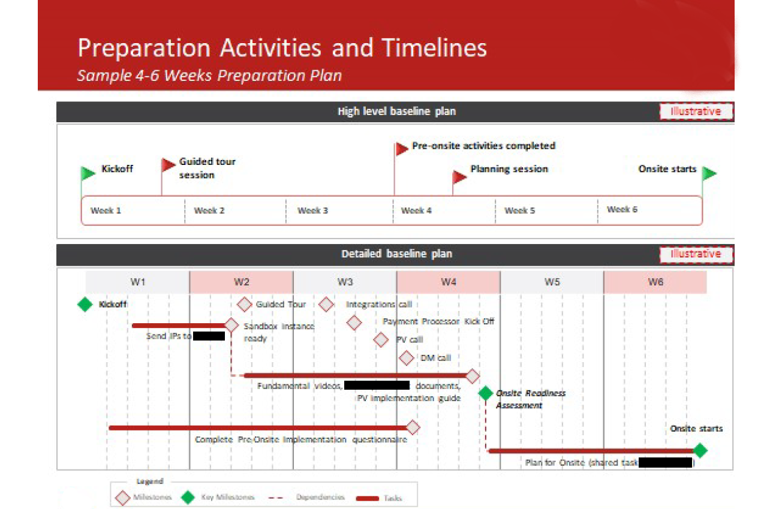
Vendor Example of Preparation Activities

Slide 8
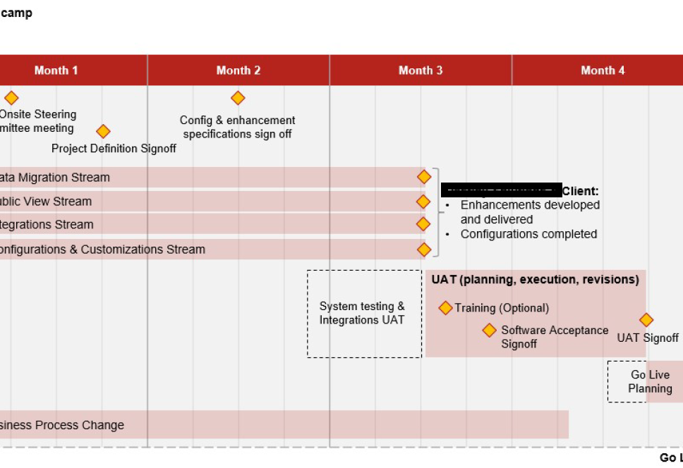
Project Timelines

Slide 9
Pre-Award Work
Identify colleges with interest and capacity to participate as implementation partners
Review/Assess workflows developed for Continuing Education through the CampusWorks efforts
Review/Assess Continuing Education data
(Colleague is the current system of record)
  Identify areas of data clean up should be considered – courses, students, etc.
  Identify core data elements required for reporting purposes that would be captured and shared through new system

Slide 10
Pilot Colleges
Beaufort CCC
Central Carolina CC
Central Piedmont CC
Forsyth TCC
Haywood CC
Lenoir CC
Piedmont CC
Rowan-Cabarrus CC
Sandhills CC
Surry CC
Wake TCC

Slide 11
Pilot College Team Representation
President
  Support of initiative and college staff engaged in successful implementation
Senior CE Administrator
  Knowledge of broad CE demands and processes
CE Operations Staff
  Knowledge of current processes around course builds, registrations, communication
IT Staff
  Knowledge of Colleague administration – ability to monitor integrations
Finance Staff
  Knowledge of payment flows, reports and ledger activity around payments and refunds

Slide 12
Pre-Award Work
CE Senior Administrators, CE Operations, IT and Finance
Review/Assess workflows developed for Continuing Education through the CampusWorks efforts
  Confirm continued relevance
  Provide updates to workflows
  Define new workflows
Doris Carver – Piedmont CC
Kimberly Blue – Sandhills CC
Margaret Roberton – NCCCS

Slide 13
Areas of Focus
Workforce Continuing Education
College and Career Readiness
Customized Training
Small Business Center – retaining separate solution
ApprenticeshipNC – retaining separate solution

Slide 14

Pre-Award Work
Information Technology
Review/Assess processes with Rowan-Cabarrus evaluation support team
WebAPI up and running and is externally available
Ken Ingle – Rowan Cabarrus CC
Rebecca Anderson – Rowan Cabarrus CC

Slide 15

Pre-Award Work
CE Senior Administrators, CE Operations, and Finance
Identify areas of data clean up – courses, students, local CCL, etc.
Identify core data elements required for reporting purposes that would be captured and shared through new system
Craig Lamb – Rowan Cabarrus CC
Becky Hall – Central Piedmont CC
Ashley Sieman – NCCCS

Slide 16

Post Assessment Work
Senior CE Administrators, CE Operations, Finance, and IT
Develop templates for Continuing Education data collection
  Registration
  Course Builds
Prioritize processes
  Student • Credentials
  Course • Pathways
  Registration • Corporate Accounts
  Reporting • Communication/Marketing
Develop checklists for college preparation

Slide 17
Post Award - Vendor
Following deliverables by the time vendor is on-site
Confirmed workflows
  Student
  Course
  Registration
Technology prepared for integration
Data requirements and recommendations
Identified templates
  Student
  Course
  Registration
Initial preparation checklist for 47 peer colleges

Slide 18
When – TENTATIVE – Aggressive Model
Pilot colleges working in new solution for Fall 2020
Remaining colleges to come on in cohorts of 6 – 8
  Proposed overlapping approach
    Wave 1 Weeks 1 – 8
    Wave 2 Weeks 6 – 13
    Wave 3 Weeks 11 – 18
    Wave 4 Weeks 16 – 24
    Wave 5 Weeks 22 – 30
    Wave 6 Weeks 28 – 36
Balance of colleges by Fall 2021
  If overlapping not possible or process delayed, then Spring 2022 expectations
Goal – all colleges working core processes for courses, students and registration and most colleges actively engaged in marketing, pathways and credentials NLT Summer 2022

Slide 19
Preparation
Identify your champions
Review local CCL
Understand and document current workflows
Prioritize needs
Map local program pathways
Identify areas of risk
Communicate with internal partners – finance, IT, marketing on workflows and processes

