Slide 1

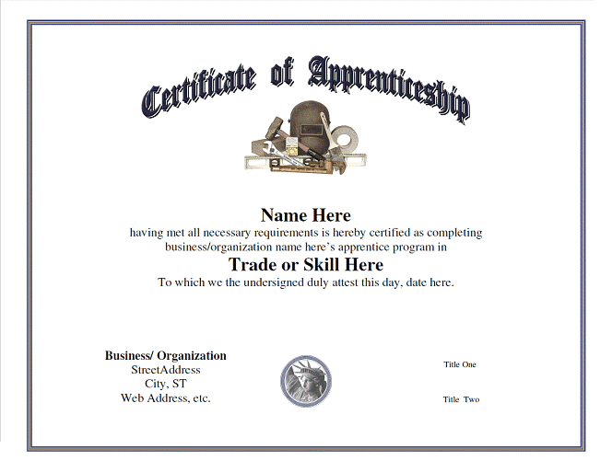



Registered Apprenticeship (RA) and Work-Based Learning (WBL): Where Pathways Diverge
Kathryn Castelloes, Apprenticeship Director, NC Department of Commerce
Frank Scuiletti, Academic Programs, System Office
JOB

Slide 2
Registered Apprenticeship and NCCCS Work-Based Learning
Registered Apprenticeship
NCCCS CTE Program
Course: | Mechatronics Engineering Technology | Credit:
BPR 111 | Print Reading | 2 SHC
ATR 112 | Intro to Automation | 3 SHC
ATR 131 | Model-Based Design | 2 SHC
ATR 115 | Intro to Mechatronics | 3 SHC
DFT 151 | CAD I | 3 SHC
WBL 111/121 | Work-Based Learning | 2 SHC
Total |  | 15 SHC
Academics
Experiential Learning
Academics
Experiential Learning

Slide 3

Mission:
To provide North Carolina with qualified and trained workers; to meet the skilled workforce needs of the state.
Registered Apprenticeship in North Carolina

Slide 4
Skills Gap
In Accenture’s 2014 Manufacturing Skills and Training Study they found that:
More than 50% of companies report plans to increase US based production by at least five percent in the next 5 years
More than 75% of manufacturers report a moderate to severe shortage of skilled resources

Slide 5
Skills Gap
45% of all jobs over the next decade will be in “middle skill” occupations, which require more than a high school diploma but less than a bachelor’s degree.

Slide 6
Problem
Young people do not know what “work” looks like and what options they have other than a four year university degree
Only 33% of jobs in North Carolina require a four year degree

Slide 7

Apprenticeship Statewide and by Prosperity Zone
data as of 7/1/2016
North Carolina
Active Apprentices 4,375
Available Programs 553
Available Trades 1,185
Northwestern Zone
Active Apprentices 151
Available Programs 40
Available Trades 97
Apprenticeship Catawba
Students of Furniture
Apprenticeship
Piedmont-Triad Zone
Active Apprentices 359
Available Programs 106
Available Trades 192
Career Apprenticeship Program
Guilford Apprenticeship Program
North Central Zone
Active Apprentices 1,403
Available Programs 163
Available Trades 361
North Carolina Triangle Apprenticeship Program
Central Carolina Caterpillar
Western Zone
Active Apprentices 274
Available Programs 31
Available Trades 40
Northeast Zone
Active Apprentices 146
Available Programs 27
Available Trades 79
Southwest Zone
Active Apprentices 947
Available Programs 85
Available Trades 174
Apprenticeship Charlotte
Apprenticeship 2000
Apprenticeship 321
South Central Zone
Active Apprentices 839
Available Programs 42
Available Trades 131
Apprenticeship Montgomery
Robeson Technical
Apprenticeship Montgomery
Southeast Zone
Active Apprentices 256
Available Programs 60
Available Trades 95
Denotes public-private apprenticeship partnership

Slide 8
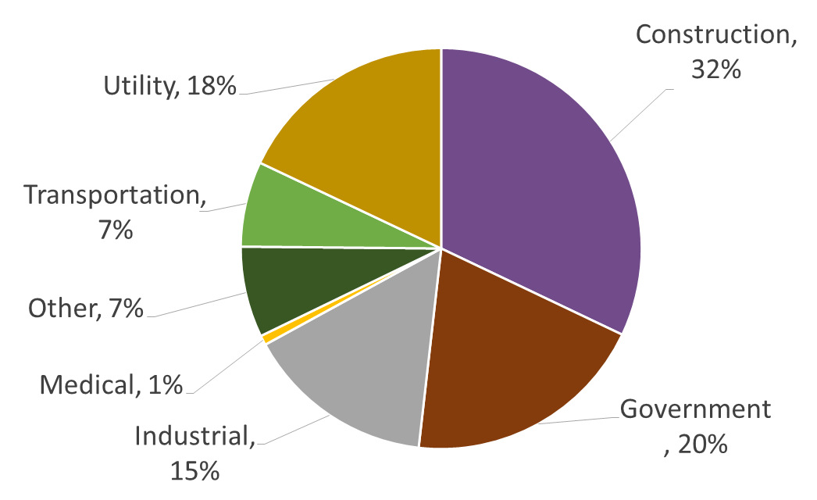
Apprenticeship State Wide
data as of 7/1/2016
Active Apprentices 4,375
Active Veterans 1,384
Available Programs 553
Available Trades 1,185
Notes:
So where is apprenticeship now in the state. This will give you a snap shot as for as where we are with number of programs, trades and apprentices within the state.

Slide 9


Registered Apprenticeship
Earn while you Learn
Other “Four Year Degree”

Slide 10

Registration Agency
The N.C. Department of Commerce, NCWorks Apprenticeship, is the State Agency to register programs for Federal purposes.
It functions under the authority of the N.C. Apprenticeship Act (Chapter 22 of the N.C. General Statutes) and the administrative rules (Title 4, Subchapter 0102 of the N.C. Administrative Code).
NCWorks Apprenticeship promotes, develops, registers and assists in the operation of registered Apprenticeship and other training programs.
NCWorks Apprenticeship develops and promotes Apprenticeship Programs throughout the state, and registers, monitors and certifies all Apprenticeship Programs.

Slide 11
Apprenticeship Cost
Many are very productive in their second year of Apprenticeship
A 2009 Return on Investment Study says that for every dollar spent on Apprenticeship training, an employer receives a benefit, on average of $1.47

Slide 12
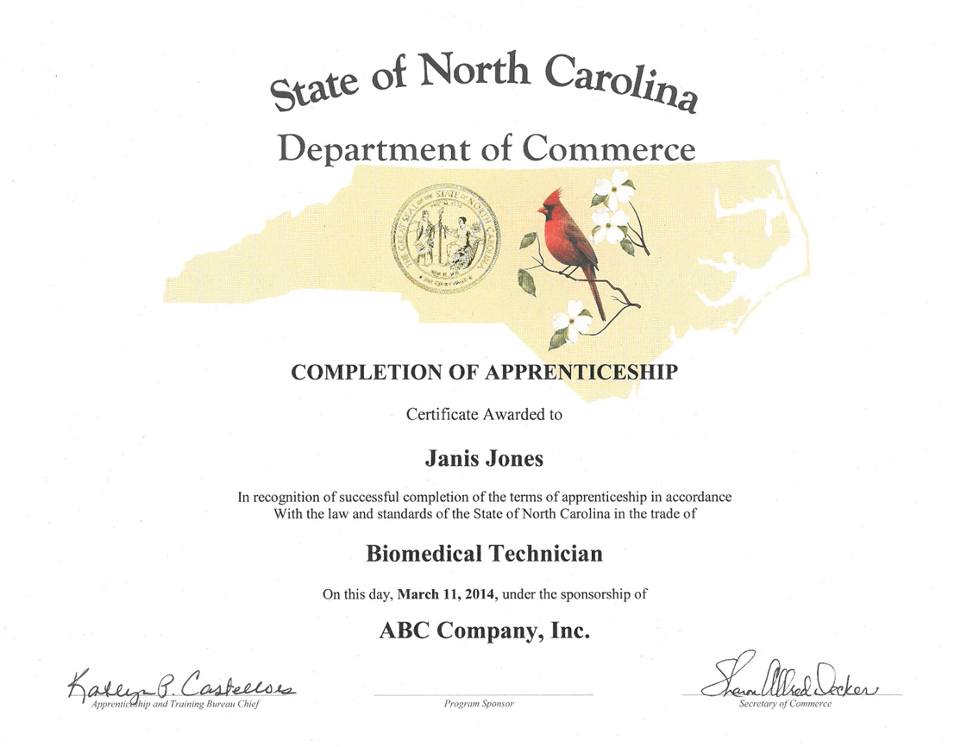

Slide 13
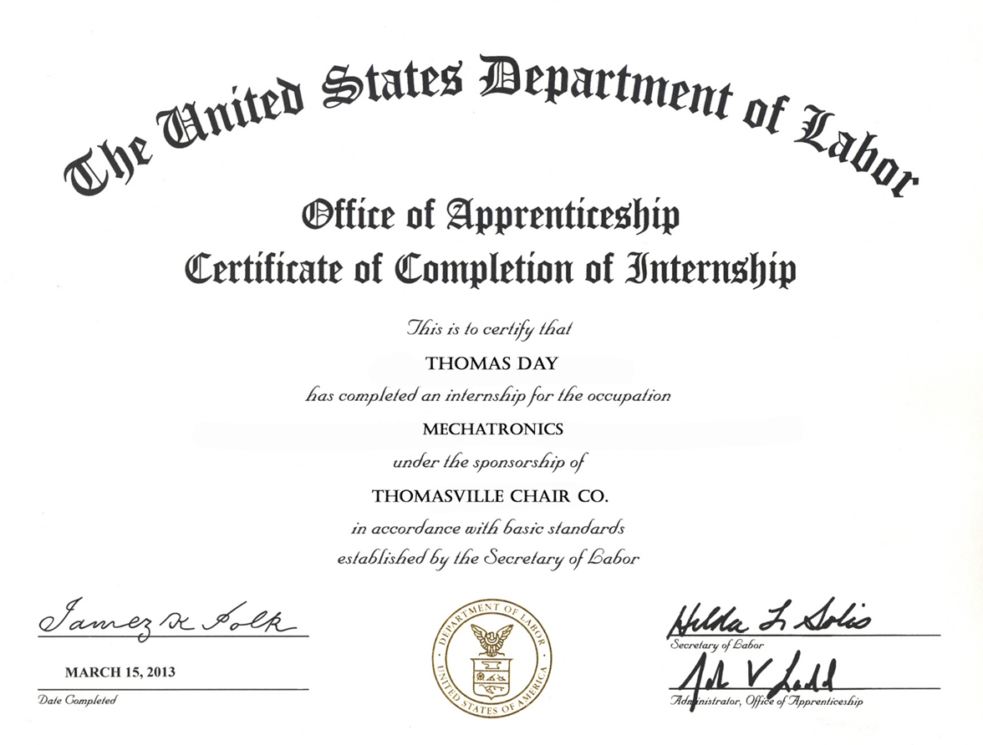

Slide 14
Pre-Apprenticeship
Pre-apprenticeship services and programs are designed to prepare individuals to enter and succeed in Registered Apprenticeship programs. They expand the participant's career pathway opportunities with industry-based training coupled with classroom instruction.

Slide 15
Examples of Pre-Apprenticeship?
High School Students
Charter Communications
Fort Bragg and Fayetteville Tech
VIP ( Veterans in Pipefitting) at Camp Lejuene
Wayne Brothers Inc.

Slide 16

Emerging Employer Consortiums
Apprenticeship 2000
Apprenticeship Charlotte
Apprenticeship Montgomery
Guilford Apprenticeship Program
Apprenticeship Catawba
NC Triangle Apprenticeship Program
Career Accelerator Program
Apprenticeship 321
Notes:
Apprentices are employees of the employer. This means they do receive compensation while they are learning in the apprenticeship.

Slide 17

Benefits for the Apprentice

Slide 18
New to Registered Apprenticeship:
Free Community College Tuition for any high school youth that enters an Apprenticeship Program
Legislature providing an extra $ 500,000 to RA
$1.03 million dollar grant submission on September 7 with sector strategies in IT, Advanced Manufacturing and Healthcare

Slide 19

Legislative Update:
Tuition Waiver
Student registered in either a Pre Apprenticeship or Registered Apprenticeship
Graduates High School- continues in RA – TUITION WAIVED

Slide 20
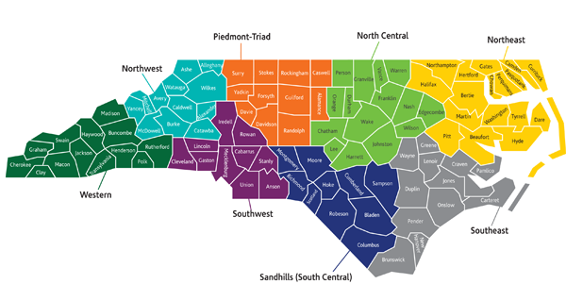
Regional Apprenticeship Summits
Notes:
Apprentices are employees of the employer. This means they do receive compensation while they are learning in the apprenticeship.

Slide 21

http://www.nccommerce.com/workforce/businesses/apprenticeship
For More Information:
Visit the NCWorks Web Site

Slide 22
NCCCS Work-Based Learning General Description
Work-Based Learning (WBL) courses - provide students with work experience in industry, business, government, health or service industry.
Students earn college credit for Work-Based Learning directly related to program of study.
Joint ventures between education and employers.
A student enrolled in a community college technical education program, may utilize WBL for the on-the-job training requirement of the apprenticeship.

Slide 23
NCCCS Work-Based Learning Information
Course Name | Course Title | Credit Hours/ Contact Hours
WBL-111, WBL-121, WBL-131, WBL-211, WBL-221, WBL-231 | Work-Based Learning I, II, III, IV, V, VI | 1/10 hours per week
WBL-112, WBL-122, WBL-132, WBL-212, WBL-222, WBL-232 | Work-Based Learning I, II, III, IV, V, VI | 2/20 hours per week
WBL-113, WBL-123, WBL-133, WBL-213, WBL-223, WBL-233 | Work-Based Learning I, II, III, IV, V, VI | 3/30 hours per week
WBL-114, WBL-124, WBL-134, WBL-214, WBL-224, WBL-234 | Work-Based Learning I, II, III, IV, V, VI | 4/40 hours per week
This course provides a work-based learning experience with a college-approved employer in an area related to the student's program of study. Emphasis is placed on integrating classroom learning with related work experience. Upon completion, students should be able to evaluate career selection, demonstrate employability skills, and satisfactorily perform work-related competencies.

Slide 24
NCCCS Work-Based Learning
Information
Course Name | Course Title | Credit Hours/ Contact Hours
WBL-115, WBL-125, WBL-135, WBL-215, WBL-225, WBL-235 | Work-Based Learning Seminar I, II, III, IV, V, VI | 1/1 hour per week
This course description may be written by the individual colleges.
Co-Requisite: Work-Based Learning Experience course

Slide 25
Work-Based Learning & Registered Apprenticeship
1G SBCCC 100.1(1)(e) Definition: Credit of one semester hour is awarded for 160 hours of "work experience"
WBL & RA = Aligned to Academic Program
WBL course experience = on-the-job training component of apprenticeship
Revised SBCC increase WBL max for students in RA:
  From 8 SHC to 16 SHC for AAS
  From 4 SHC to 16 SHC for Diploma
  Certificate: No change

Slide 26

Thank You! Safe Travels!

