Slide 1


Teaching Pathway to
Employment Courses
-Explore various Pathways to Employment
-Teach and Validate Critical Employment Skills
-Provide Opportunity for Certifications
-Show Students what Jobs Look/Feel like
-Help Students Discover Themselves
-Mentor and Facilitate Learning
-Motivate!
- Not a Capstone Course
Notes:
Do students know where they are and where they are going to when out on the open sea of life? Probably not. Educators can help them locate themselves. Revised dual-enrollment policies had great impact on programs including Huskins, Learn and Earn Online, and Concurrent Enrollment, that were combined into CCP. Combining it into one program helped make Career and College Promise become very successful.

Slide 2
Course Outline
Module 1: Safety
Module 2: Communication Skills
Module 3: Industry Overview
Module 4: Computation and Financial Literacy
Module 5: Employability Skills
Module 6: Personal Health
Module 7: Career Pathways including Apprenticeship
Module 8: Job Preparation and Required Job Skills
Module 9: Industry and Site Visits
Notes:
Students who understand these components should be ready to begin work, in conjunction with technical training specific to their chosen profession. There should be little redundancy between these course competencies and the technical course competencies that exist in other program courses. These competencies should be the most important ones students need before walking onto a job site.

Slide 3
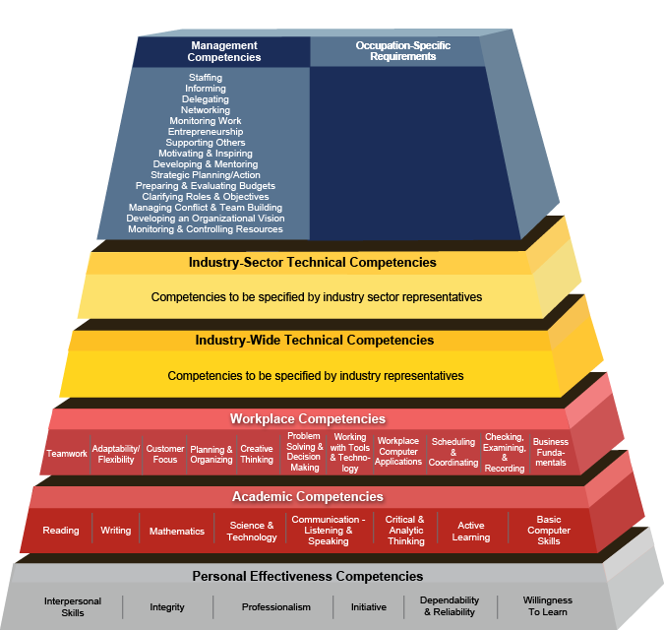


National Models
Competency Model
Clearinghouse
Standardization is possible at Foundational Levels
Notes:
The lower three tiers are where Employability Skills exist. The lowest tier is soft skills. Pre-apprenticeship skills focus in on those lower tiers. These skills are transferable across all careers. The higher tiers are where specialization occurs and where employers may require apprentices to learn skills specific to their company.

Slide 4

MC3: Multi-Core Example
There are nine sectors or chapters in the MC3:
• Construction Industry Orientation
• Tools and Materials
• Construction Health and Safety
• Blueprint Reading
• Basic Math for Construction
• Heritage of the American Worker
• Diversity in the Construction Industry
• Green Construction
• Financial Literacy
Notes:
This core leads to several different construction pathways. It was co-developed with many different partners including the AFL-CIO.

Slide 5
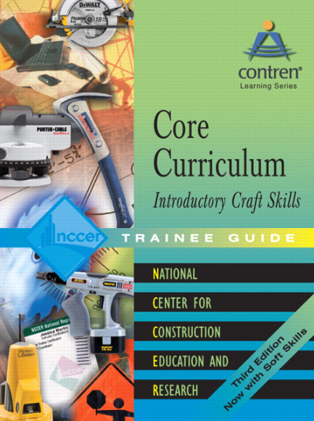
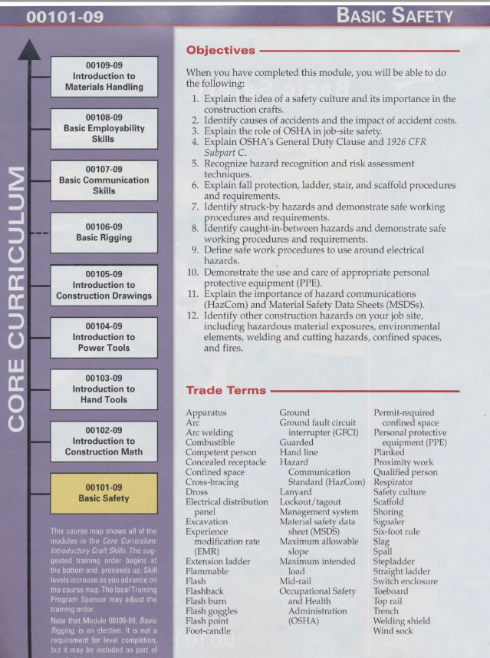
NCCER Construction Core Skills
Notes:
Here’s the national NCCER Core model that’s required for all DPI construction programs.

Slide 6
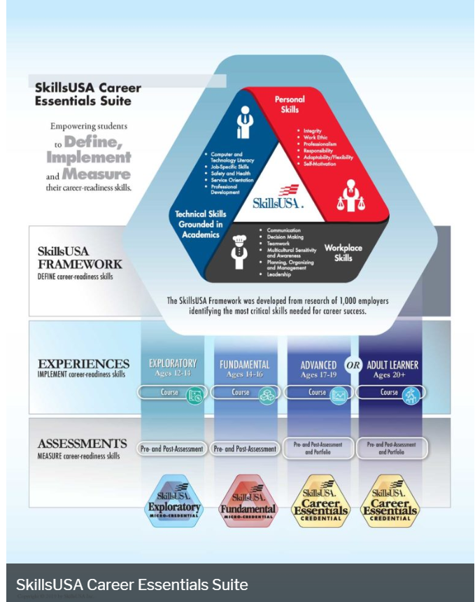
SkillsUSA:
Developing Career-Ready Skills
Is
Essential

Slide 7
Standardized Pre-Apprenticeship
Objective: Develop 80-hour curriculum courses (2-3-3 SHC) for popular NCCCS major curriculum program areas that may also serve as standardized Pre-apprenticeship through ApprenticeshipNC when tied to an Apprenticeship.
PTE 110 PTE Construction
Draft course outline:
Safety Awareness.
Communication Skills.
Public Service (motivation (why serve?), org awareness/structure, societal issues, agency interaction, etc.).
Related Computer Skills.
Computational Ability (basic math, personal & business finances, etc.).
Communication Devises and Technologies (what is used in various professions, vehicles, chemicals, radios, photography, etc.).
Government (Structure, law, agencies, authority).
Employability Skills (online program).
Personal Health (explore job physical requirements, determine aptitude, CPR, First Aide, etc.), Mental Health, and Physical Health (Fitness).
Career Exploration and Job Skills (visit Corrections, FIP, CJ, EM, EMS programs/orgs). KSAs. Examinations and Certifications.
Visitations. Locate facilities. Visit and interview (mock or actual).
Etc.
PTE 111 PTE Manufacturing
Draft course outline:
Safety Awareness.
Communication Skills.
Public Service (motivation (why serve?), org awareness/structure, societal issues, agency interaction, etc.).
Related Computer Skills.
Computational Ability (basic math, personal & business finances, etc.).
Communication Devises and Technologies (what is used in various professions, vehicles, chemicals, radios, photography, etc.).
Government (Structure, law, agencies, authority).
Employability Skills (online program).
Personal Health (explore job physical requirements, determine aptitude, CPR, First Aide, etc.), Mental Health, and Physical Health (Fitness).
Career Exploration and Job Skills (visit Corrections, FIP, CJ, EM, EMS programs/orgs). KSAs. Examinations and Certifications.
Visitations. Locate facilities. Visit and interview (mock or actual).
Etc.
PTE 112 PTE Public Safety
Draft course outline:
Safety Awareness.
Communication Skills.
Public Service (motivation (why serve?), org awareness/structure, societal issues, agency interaction, etc.).
Related Computer Skills.
Computational Ability (basic math, personal & business finances, etc.).
Communication Devises and Technologies (what is used in various professions, vehicles, chemicals, radios, photography, etc.).
Government (Structure, law, agencies, authority).
Employability Skills (online program).
Personal Health (explore job physical requirements, determine aptitude, CPR, First Aide, etc.), Mental Health, and Physical Health (Fitness).
Career Exploration and Job Skills (visit Corrections, FIP, CJ, EM, EMS programs/orgs). KSAs. Examinations and Certifications.
Visitations. Locate facilities. Visit and interview (mock or actual).
Etc.
PTE 113 Transportation
Draft course outline:
Safety Awareness.
Communication Skills.
Public Service (motivation (why serve?), org awareness/structure, societal issues, agency interaction, etc.).
Related Computer Skills.
Computational Ability (basic math, personal & business finances, etc.).
Communication Devises and Technologies (what is used in various professions, vehicles, chemicals, radios, photography, etc.).
Government (Structure, law, agencies, authority).
Employability Skills (online program).
Personal Health (explore job physical requirements, determine aptitude, CPR, First Aide, etc.), Mental Health, and Physical Health (Fitness).
Career Exploration and Job Skills (visit Corrections, FIP, CJ, EM, EMS programs/orgs). KSAs. Examinations and Certifications.
Visitations. Locate facilities. Visit and interview (mock or actual).
Etc.
PTE 114 PTE Engineering Technology
Draft course outline:
Safety Awareness.
Communication Skills.
Public Service (motivation (why serve?), org awareness/structure, societal issues, agency interaction, etc.).
Etc.
PTE 115 PTE Ag & Nat’l Resources
Draft course outline:
Safety Awareness.
Communication Skills.
Public Service (motivation (why serve?), org awareness/structure, societal issues, agency interaction, etc.).
Etc.
PTE 116 PTE Biological and Chemical
Draft course outline:
Safety Awareness.
Communication Skills.
Public Service (motivation (why serve?), org awareness/structure, societal issues, agency interaction, etc.).
Etc.
PTE 117 PTE Commercial & Artistic
Draft course outline:
Safety Awareness.
Communication Skills.
Public Service (motivation (why serve?), org awareness/structure, societal issues, agency interaction, etc.).
Etc.
PTE 118 PTE Education
Draft course outline:
Safety Awareness.
Communication Skills.
Public Service (motivation (why serve?), org awareness/structure, societal issues, agency interaction, etc.).
Etc.
PTE 119 PTE Business
Draft course outline:
Safety Awareness.
Communication Skills.
Public Service (motivation (why serve?), org awareness/structure, societal issues, agency interaction, etc.).
Etc.
PTE 120 PTE Information Technology
Draft course outline:
Safety Awareness.
Communication Skills.
Public Service (motivation (why serve?), org awareness/structure, societal issues, agency interaction, etc.).
Etc.
PTE 121 PTE Health
Draft course outline:
Safety Awareness.
Communication Skills.
Public Service (motivation (why serve?), org awareness/structure, societal issues, agency interaction, etc.).
Etc.

Slide 8
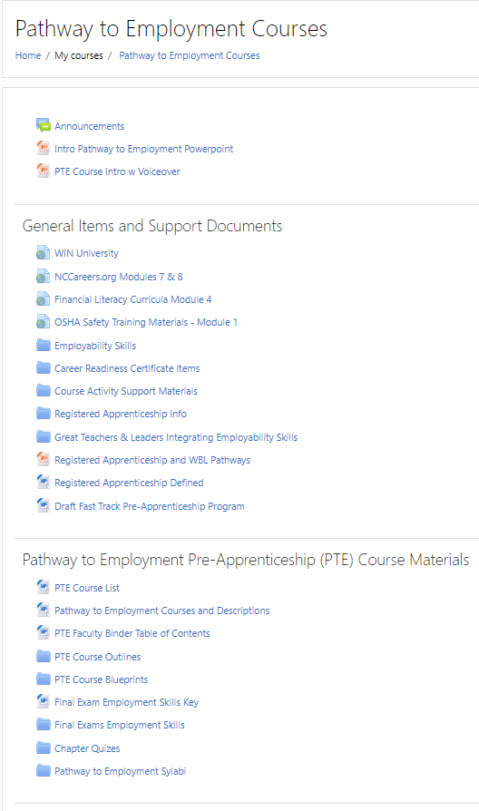
Course Materials: https://moodle.nccommunitycolleges.edu/
Utilize the instructional materials for traditional or online course.
Instructor provides classroom instruction that sets the stage for completion of each module.
Student completes assignments (job sheets) during lab period. Instructor becomes facilitator.
Students requires access to the internet. No textbook.
Follow Course Blueprints outlining Student Learning Outcomes.
Requires good coaching: Motivate students to follow their pathway to the Summit.
Notes:
Course resources have been developed including syllabi, lesson plans and job sheets, and include support materials. Many of the modules would be nearly identical across disciplines.

Slide 9
What You want to Teach is what
You want Students to Learn
Upon completion, students should be able to explain how to: locate and engage employers, present themselves in a professional manner, perform basic on-the-job skills, pursue necessary job-specific training and/or certification, and enter a career with the knowledge required to be successfully employed.

Slide 10
Contact Information:
Frank Scuiletti, Ed.D.
Senior Program Administrator: Construction, Engineering, Industrial, Transport & Work-Based Learning Coordinator
NC Community College System Office, Raleigh, NC, 27699
919-807-7114
scuilettif@nccommunitycolleges.edu

