Slide 1

AACC Leadership Competencies
Focus Area: Mid-Level Leaders
AACC Competencies for CC Leaders/
https://www.aacc.nche.edu/publications-news/aacc-competencies-for-community-college-leaders/

Slide 2
Organizational Culture
Embrace the mission, vision, and values of your college and acknowledge the significance of her past while charting the future.

Slide 3
Organizational Culture Cont.
Mission, Vision, and Values of the College
  Learn about the college’s mission, vision, and values.
  How does your role support them?
  Does your career path fit?
Culture of the Institution and the External Community
  Gain an understanding of the culture of the institution.
  Can you effectively perform your duties within that cultural construct/framework?

Slide 4
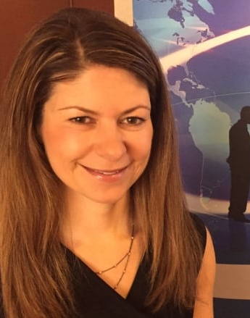
Catherine Courage
Three Strategies to develop a culture of creativity
  Environments
  Experiments
  Storytelling
What is one thing you can do in your area to promote creativity?
Click to Catherine Courage video
https://www.youtube.com/watch?v=01Y7qlPFpqw&feature=youtu.be

Slide 5
Governance, Institutional Policy, and Legislation
Grow your knowledge about the institutions governance framework and the policies that guide her operations.

Slide 6
Governance, Institutional, Policy, and Legislation Cont.
Organizational Structure
  Learn the college’s organizational structure and the function your unit plays.
  How can you lead to achieve the institutional goals?
Governance Structure
  Learn the college’s governance structure.
  What is your strategy to lead from the middle?

Slide 7
Governance, Institutional, Policy, and Legislation Cont. 2
College Policies/Procedures
  Learn the college’s policy/procedures.
  Are you in compliance? Are you in conflict with other functional areas or external areas?
Board Relations
  Learn the president’s expectations of your role.
  Do you advocate for change in policies and procedures to better implement the vision?

Slide 8
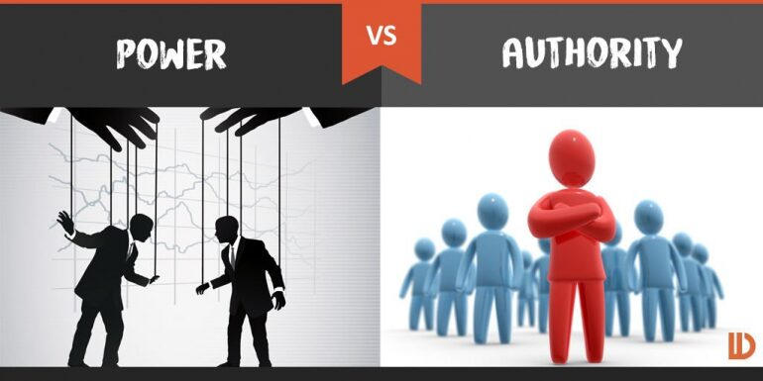
Authority vs Power
To remain in compliance with an external agency, employees in another functional area must accomplish specific tasks; they are not.
What leading-from-the-middle strategies could you use to help this situation?

Slide 9
Student Success
Support student success across the institution, and embrace opportunities to improve access, retention, and success.

Slide 10
Student Success Cont.
Student success
  Learn the college’s student success agenda.
  How can you lead your area to support that agenda?
Consistency Between Operations and Agenda
  With your supervisor, evaluate your operations in comparison to the success agenda.
  What operational changes do you need to make to better support student success?
Data Usage
  Learn what and how data can be used to improve policy/process for student success?
  What do you need to measure and analyze? Are you willing to change?

Slide 11
Student Success Cont.2
Program/Performance Review
  Learn about the college’s program reviews.
  Do you embrace program and performance reviews as continuous improvement?
Evaluation for Improvement
  Learn to honestly look in the mirror.
  Are you doing your very best to support student success?

Slide 12

Student Success Cont. 3
How does your college define student success?
What is one student success strategy/intervention that you can lead or support?

Slide 13
Institutional Leadership
Understand the importance of interpersonal relationships, personal philosophy, and management skills to create a student-centered institution.

Slide 14
Institutional Leadership Cont.
Be An Influencer – Embrace your role as a leader from the middle.
Support Team Building – Be willing to be open, honest, and positive during team building experiences.
Performance Management – Seek your supervisor’s expectations and improvements; provide the kind of performance reviews you would like.
Lead By Example – Set a positive example.
Problem-solving Techniques – Solution-focused assessment, remedies, and evaluation.
Conflict Management – Learn and apply great conflict management.
Advocate for Professional Development – Leaders are life-long learners.
Customer Service – Shepherd students through policies/processes.
Transparency – Be open, honest, forthright.

Slide 15

Growth Mindset
Identify one strength on which you can build.
Identify one growth area where you are willing to intentionally grow.
Identify one growth area where you need a colleague.

Slide 16
Institutional Infrastructure
Fluently manage the foundational aspects of the institution: strategic plan, financial/facilities management, accreditation, and technology plan.

Slide 17
Institutional Infrastructure Cont.
Strategic Plan
  Fully participate in the planning process.
  Have you mapped your goals to support the strategic plan?
Budgeting
  Be fiscally responsible.
  Do you understand budgeting and spending at the college?
Prioritization of Resources
  Have knowledge of all the resources available to you.
  How can you better use those resources to accomplish your goals?

Slide 18
Institutional Infrastructure Cont. 2
Accreditation
  Understand regional and other accreditations at your college.
  What are your responsibilities to each accrediting body?
Facilities Plan
  Be a good steward of your workspace.
  How can you maximize space to better serve students?
Technology Plan
  Maintain awareness of the latest technology.
  What strategy do you use to advocate for needed technology?

Slide 19
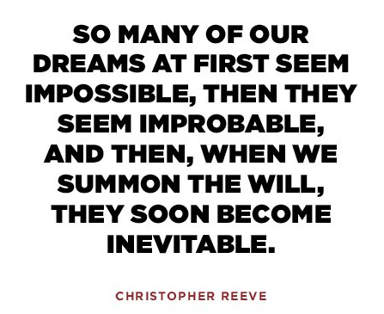
Dream Big and Small Steps
If you had all the needed recourses and knew you wouldn’t fail, what would you do in your area?

Slide 20
Information and Analytics
Understand how to use data that holistically represents the institution’s performance and be open to data that reveals unexpected trends/issues.

Slide 21
Information and Analytics Cont.
Qualitative and Quantitative
  Use both types of data.
  Do you use data to inform your decisions?
Data Analytics
  Learn data analytics and interpretation techniques.
  Who can teach you to grow in your data analytics?

Slide 22
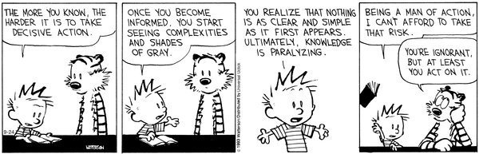
Decision Making: Head vs Gut

Slide 23
Advocacy and Mobilizing/Motivating Others
Embrace the importance of championing ideals and mobilize stakeholders to take action on behalf of the college and her students and connect the college with the community using available communication resources.

Slide 24
Advocacy and Mobilizing/Motivating Others Cont.
Community College Ideals
  Identify the ideals with which you relate.
  Do you seize opportunities to advocate/speak about the mission of the college?
Stakeholder Mobilization
  Learn mobilization strategies.
  Who do you need to mobilize?
Media Relations – Learn and follow college policy/procedures.
Marketing – How can you better market your functional area?

Slide 25
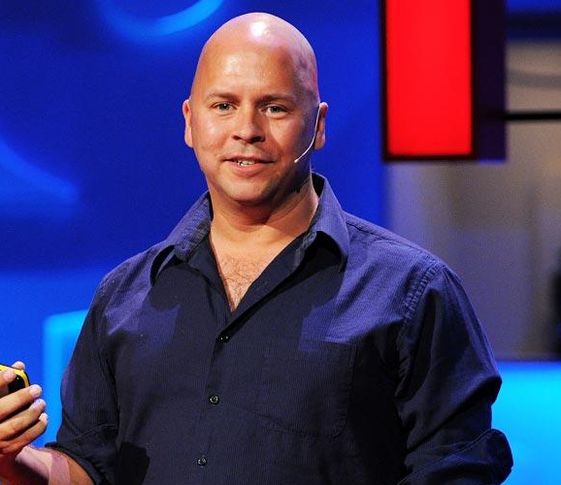
Derek Sivers
Click to hear Derek Sivers
https://www.ted.com/talks/derek_sivers_how_to_start_a_movement?utm_campaign=tedspread&utm_medium=referral&utm_source=tedcomshare

Slide 26
Fundraising and Relationship Cultivation
Cultivate relationships that support the institution and advance the colleges agenda.

Slide 27
Fundraising and Relationship Cultivation Cont.
Fundraising
  Learn strategies and procedures to seek grant funds.
  What grants could you pursue to improve your services to students?
Alumni Relationships
  Participate in alumni activities.
  How could alumni partnerships improve your services to students?
Media Relationships – Learn strategies for working with media.
Legislative Relationships – Learn laws/policies about engaging with legislators.
Public Relations – Understand that you always represent the college.
Workforce Partnerships – Learn about the college’s workforce mission.

Slide 28
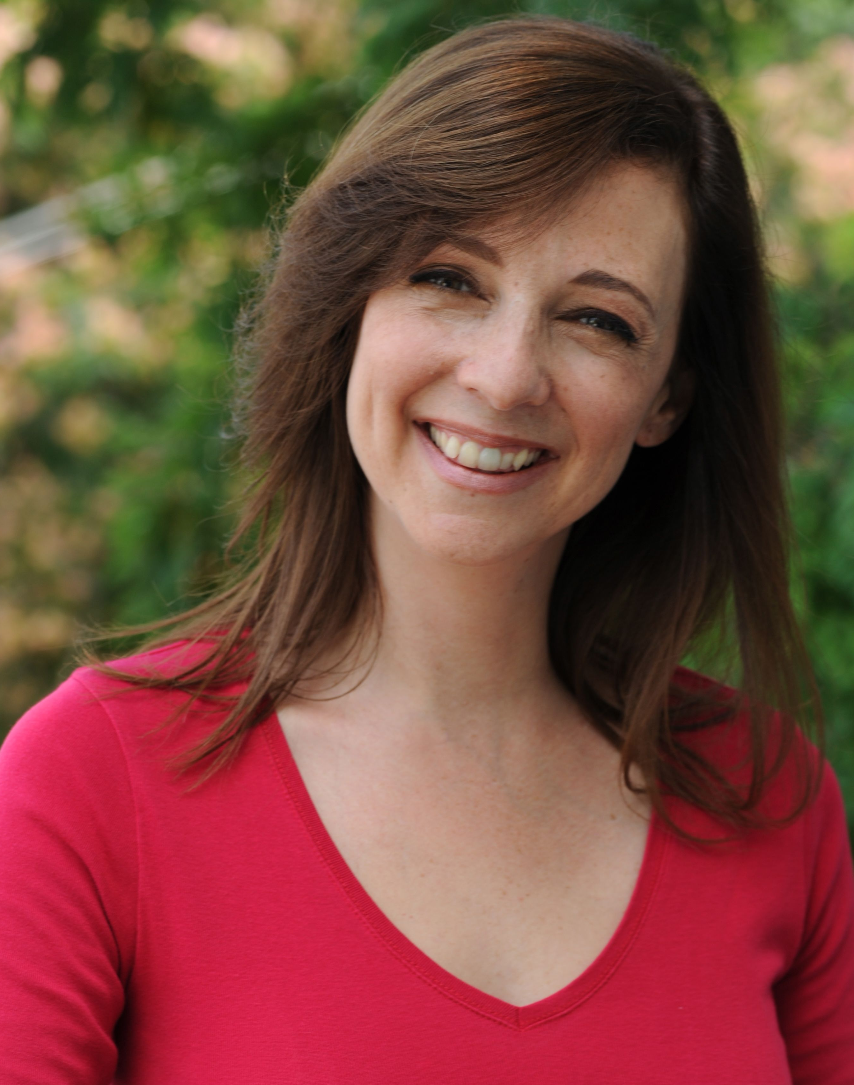
Susan Cain
What are the strengths and weaknesses of Extroverts and Introverts?
Click video on extroverts and introverts
https://www.ted.com/talks/susan_cain_the_power_of_introverts?utm_campaign=tedspread&utm_medium=referral&utm_source=tedcomshare

Slide 29
Communications
Demonstrate strong communication skills and embrace the role of a college spokesperson.

Slide 30
Communications Cont.
Presentation, Speaking, and Writing Skills
  Seize opportunities to present and speak.
  Who do you trust to give you valuable guidance to improve your communication skills (verbal and written)?
Active Listening
  Learn and practice active listening skills.
  Do you listen more than you talk? Do you listen before you talk?
Global and Cultural Competence
  Be open to fully participating in cultural competence training.
  Have you identified the cultural influences on your communication style/skills?
Strategies for Multi-generational Engagement
  Be open to fully participating in generational competence training.
  Have you identified the generational influences on your communication style/skills?

Slide 31
Communications Cont. 2
Email Etiquette
  Learn best practices for the use of email.
  Who can provide feedback on your emails before you send them?
Fluency with Social Media
  Learn social media strategies to better serve your students.
  What emerging technologies do you need to research for use at your college?
Consistency In Messaging
  Slow down; think before posting, sending, or talking.
  How do you lead your area to ensure that student communications are consistent?
Crisis Communications
  Be familiar with the college’s crisis management and communications plans.
  What are your responsibilities during crisis? Who is your back up?

Slide 32
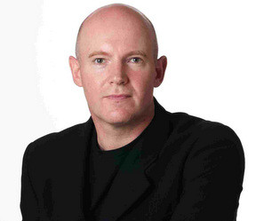
Julian Treasure
click on video of 5 ways to listen better
https://www.ted.com/talks/julian_treasure_5_ways_to_listen_better?utm_campaign=tedspread&utm_medium=referral&utm_source=tedcomshare

Slide 33
Collaboration
Develop and maintain responsive, cooperative, mutually beneficial, and ethical internal and external relationships that nurture diversity, promote success of the college community, and sustain the college mission.

Slide 34
Collaboration Cont.
Interconnectivity and Interdependence
  Learn the relationships and politics between faculty, staff, administrators, and students.
  How can you partner with others to improve your service to students?
Work with Supervisor
  Talk to your supervisor.
  Who can help you when you have conflict with your supervisor?
Institutional Team Building
  Be a team player.
  Do you give and receive assistance?

Slide 35

Intentionally Observant & Engaged
Awareness Test
https://www.youtube.com/watch?v=Ahg6qcgoay4&feature=youtu.be

Slide 36
Personal Traits and Abilities
Grow personal traits and adopt a focus on honing abilities that promote the community college agenda.

Slide 37
Personal Traits and Abilities Cont.
Authenticity – Be willing to honestly learn and grow.
Emotional Intelligence – Be able to manage your morale.
Courage – Try new strategies and advocate for new approaches.
Ethical – Approach relationships to build and to give trust.
Self-management – Manage yourself and your actions professionally.
Time Management and Planning – Manage your prioritized activities.
Familial Impact – Be aware of your personal responsibilities.
Forward-looking – Engage with professional associations that are future-looking.
Embrace Change – Be willing to change.

Slide 38
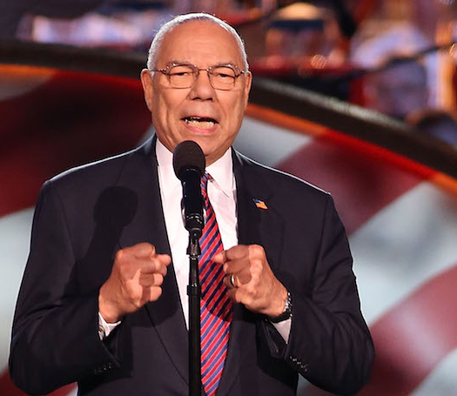
Colin Powell
Click on video of Colin Powell https://www.youtube.com/watch?v=ocSw1m30UBI&feature=youtu.be

Slide 39
James “JW” Kelley
AVP – Student Services
NC Community College System Office
kelleyj@nccommunitycolleges.edu
919-807-7108

