Slide 1





NC Guided Pathways to Success Network 2018 Cohort
NIC Facilitators Institute
May 16th , 2018
SOAA Validating & Coaching
Bobbie Frye

Slide 2

Workshop #2 Overview
COMMUNITY COLLEGE RESEARCH CENTER
Review the CCRC Guided Pathways Scale of Adoption assessment process (5 minutes)
How to conduct the SOA follow-up interviews (25 minutes)
Interview activity (10 minutes)
Debrief and discuss the interviews (10 minutes)
Summarizing and documenting the SOA information
Q&A

Slide 3
Guided Pathways Scale of Adoption Assessment: A 6-step process
COMMUNITY COLLEGE RESEARCH CENTER
Introducing the assessment
Administering the assessment to colleges
Conducting follow-up calls with college teams
Summarizing and documenting information from reports and calls
Sharing the findings with colleges
Designing coaching, workshops, and TA activities to supporting scale implementation

Slide 4
Purpose of the Assessment
COMMUNITY COLLEGE RESEARCH CENTER
✓To help colleges reflect on where they are and develop a plan for next steps
✓To gather information about colleges activities, practices, & challenges
✓To see what other colleges are doing, to learn from other colleges
✓To design coaching, workshops, and technical assistance activities
✓Track colleges’ progress over time; re-assess college needs and challenges
✓What it is not: An evaluation of college practices

Slide 5
COMMUNITY COLLEGE RESEARCH CENTER
COMMUNITY COLLEGE RESEARCH CENTER
Guided Pathways Scale of Adoption Interviews

Slide 6
Materials/Review
COMMUNITY COLLEGE RESEARCH CENTER
CCRC Guided Pathways Scale of Adoption Assessment
Sample completed SOA Assessment
CCRC SOA follow-up notes and interview protocol
Sample completed SOA follow-up notes and protocol
CCRC Guided Pathways Practice Indicators
Common challenges and sample follow-up questions
Guided Pathways SOA assessment “megatemplate”
Michigan Guided Pathways SOA summary memo

Slide 7
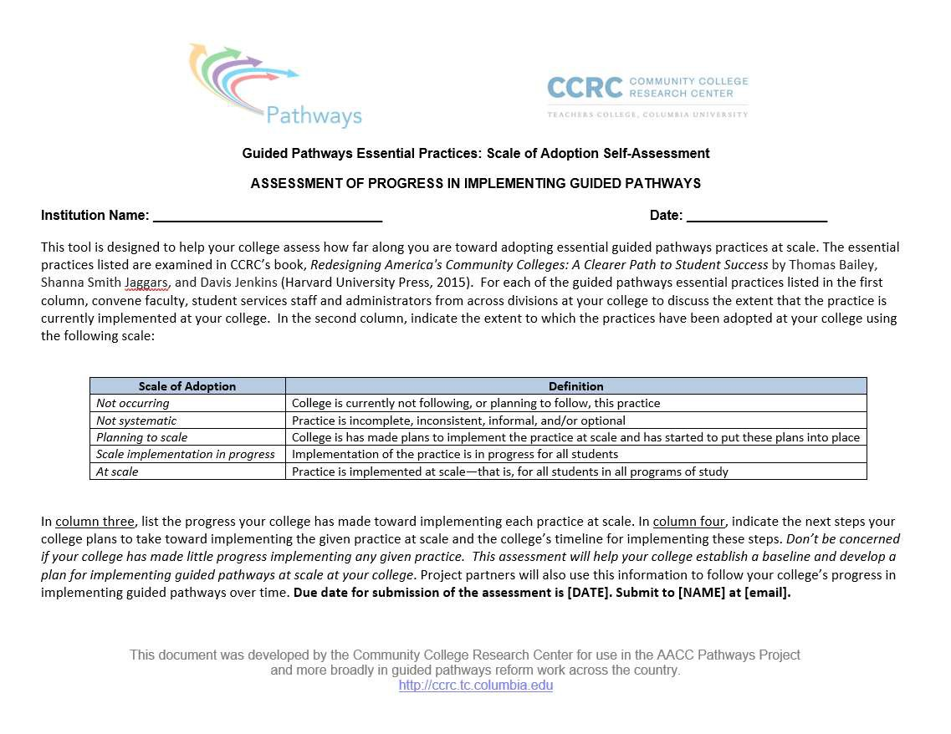
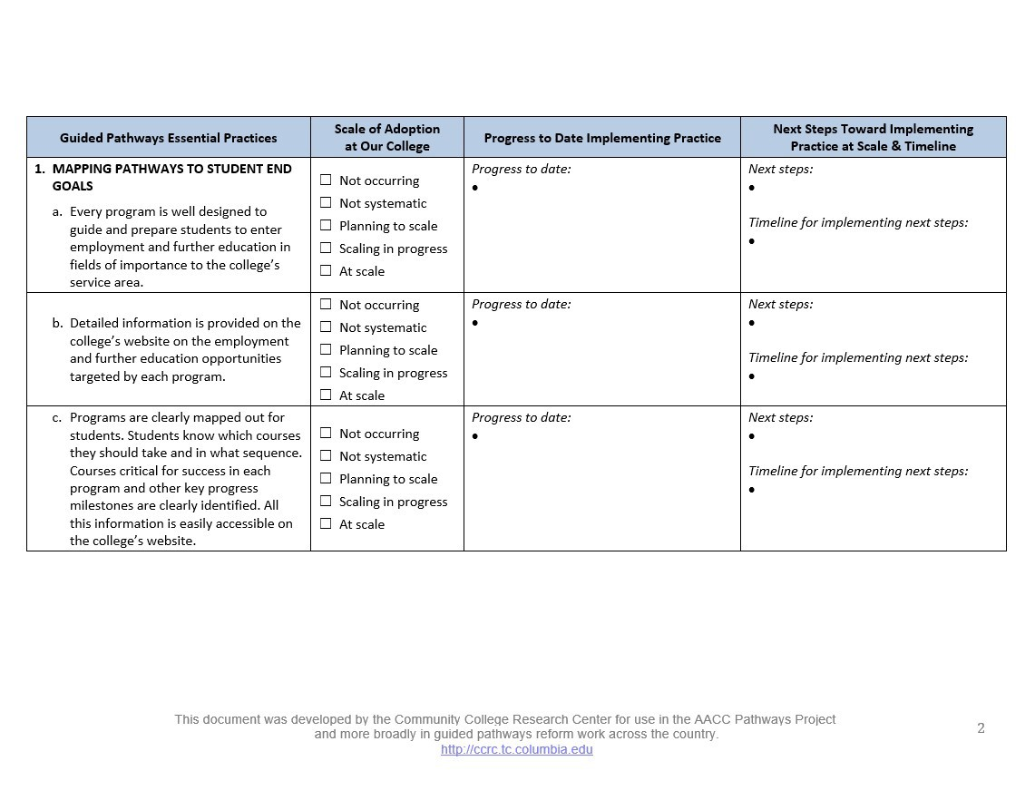
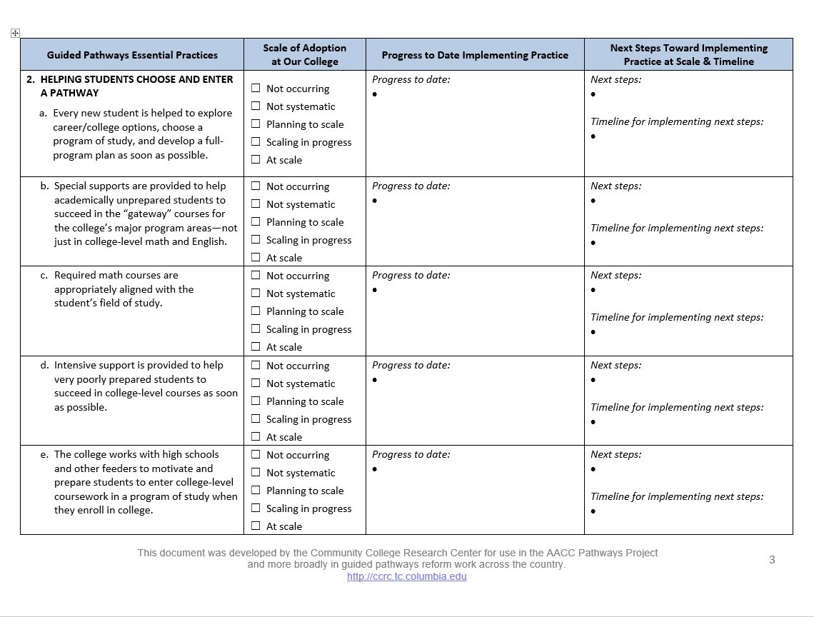
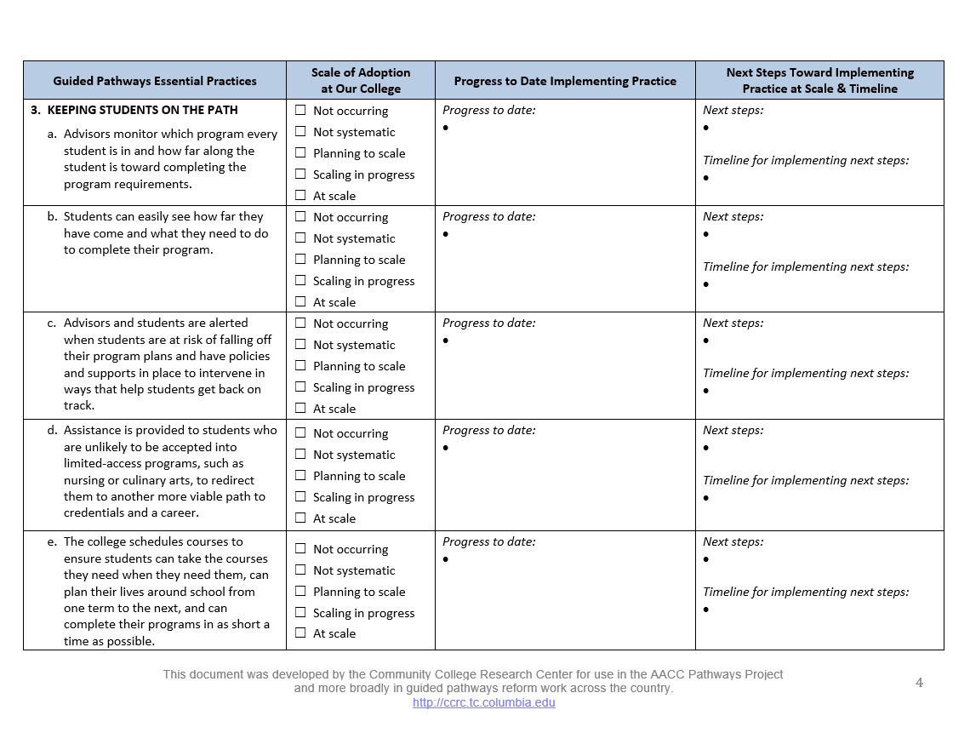
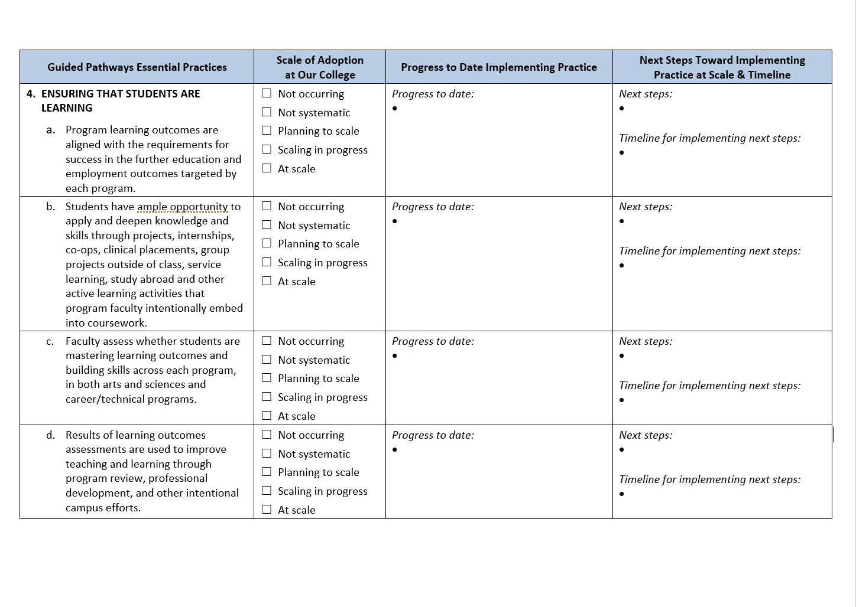
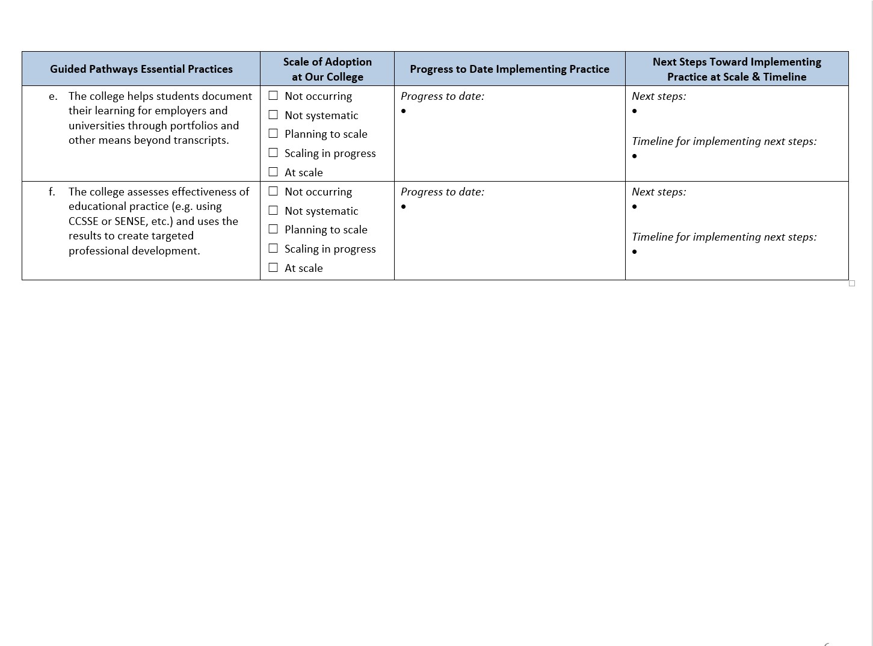
Guided Pathways Scale of Adoption Assessment and Planning Tool
COMMUNITY COLLEGE RESEARCH CENTER

Slide 8
Introducing the Assessment to Colleges
COMMUNITY COLLEGE RESEARCH CENTER
Background and Overview
  Background of assessment
  Purpose of the assessment (“Why are we doing
this?”)
  Review the four pathways practice areas
    Mapping pathways
    Helping students choose and enter the path
    Keeping students on the path
    Ensuring that students are learning
  Review/define the scale

Slide 9
Follow-up Interview Protocol and Notes
COMMUNITY COLLEGE RESEARCH CENTER
Pre-read #3 (blank protocol and notes)
Interview Protocol: 5 parts
  Introductions and overview of call (2-3 minutes)
  Review the scale (5 minutes)
  Discuss the college’s process of completing the assessment (5- 10 minutes)
  Discuss the essential practices (50 minutes)
  Follow-up questions
Notes Template
  Review extra questions
Sample follow-up interview notes (pre-read #4)

Slide 10

Guided Pathways Practice Indicators & Challenge Areas and follow-up questions
COMMUNITY COLLEGE RESEARCH CENTER
Pre-reads #5 and #6
  CCRC Guided Pathways Practice Indicators
  Common Challenge Areas and sample follow-up questions
  For follow-up interviews and coaching

Slide 11
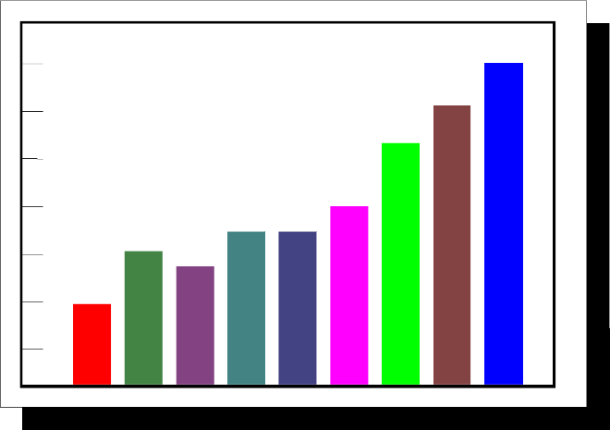
Sample Guided Pathways SOA Report
COMMUNITY COLLEGE RESEARCH CENTER
Where are the gaps? What follow-up questions should you ask?
  Mapping Pathways to Student End Goals
  Helping Students Choose and Enter a Path
  Keeping Students on their Path
  Ensuring that Students are Learning
Interview prep:
  With your partner, pick one practice area, take 5 minutes to review the sample report, compare with pre-reads #5 and #6, and come up with 3 follow-up questions.
  What questions would/will you ask?

Slide 12

Interviewing Techniques/Strategies
COMMUNITY COLLEGE RESEARCH CENTER
✓Structure the interview at the beginning
✓Ask open ended questions (avoid yes/no)
✓Use re-statements and paraphrasing
✓Ask for clarification
✓Develop discrepancy
✓Be encouraging/affirming
✓Focus on the “what,” not the rating

Slide 13
COMMUNITY COLLEGE RESEARCH CENTER
Practicing the Scale of Adoption Interviews
Use the sample Scale of Adoption Report (pre-read #3), the Guided Pathways Practice Indicators (#5), and the Common challenge areas/Sample follow-up questions (#6)
Focus areas:
  Introductions and overview
  Mapping pathways to student end goals
  Helping students choose and enter a path

Slide 14
COMMUNITY COLLEGE RESEARCH CENTER
COMMUNITY COLLEGE RESEARCH CENTER
Debriefing the Interviews

Slide 15
Take 5 minutes to think about:
COMMUNITY COLLEGE RESEARCH CENTER
What was your overall reaction to interviewing the “college”?
What was most difficult? (can you give an example?)
What’s a question that you wish you’d asked?
What is an example of a well-done probe?
What questions do you have?

Slide 16
COMMUNITY COLLEGE RESEARCH CENTER
COMMUNITY COLLEGE RESEARCH CENTER
Summarizing and Documenting the Data

Slide 17
Summarizing and Using the SOA information
COMMUNITY COLLEGE RESEARCH CENTER
Creating a state “megatemplate” (pre-read #7)
Drafting a summary memo (pre-read #8)
  For each guided pathways practice area, discuss:
    Areas of progress
    Challenge areas
  Where there any common questions, areas of confusion, or common requests for assistance?
Sharing this information with the colleges, next steps.

Slide 18
For more information
COMMUNITY COLLEGE RESEARCH CENTER
COMMUNITY COLLEGE RESEARCH CENTER PRESENTATION TITLE IN HEADER / JUNE 8, 2012
24
Please visit us on the web at
http://ccrc.tc.columbia.edu
where you can download presentations, reports, and briefs, and sign-up for news announcements. We’re also on Facebook and Twitter.
Community College Research Center Teachers College, Columbia University
525 West 120th Street, Box 174, New York, NY 10027 E-mail: ccrc@columbia.edu Telephone: 212.678.3091
Hana Lahr
Davis Jenkins
John Fink
Soumya Mishr

