Slide 1







Pathways to Transfer Success Advising Workshop
March 1, 2018
Davidson County Community College
Serving 58 Community Colleges

Slide 2


Welcome from our college host
Margaret Annunziata
Vice President of Academic Affairs
Davidson County Community College

Slide 3
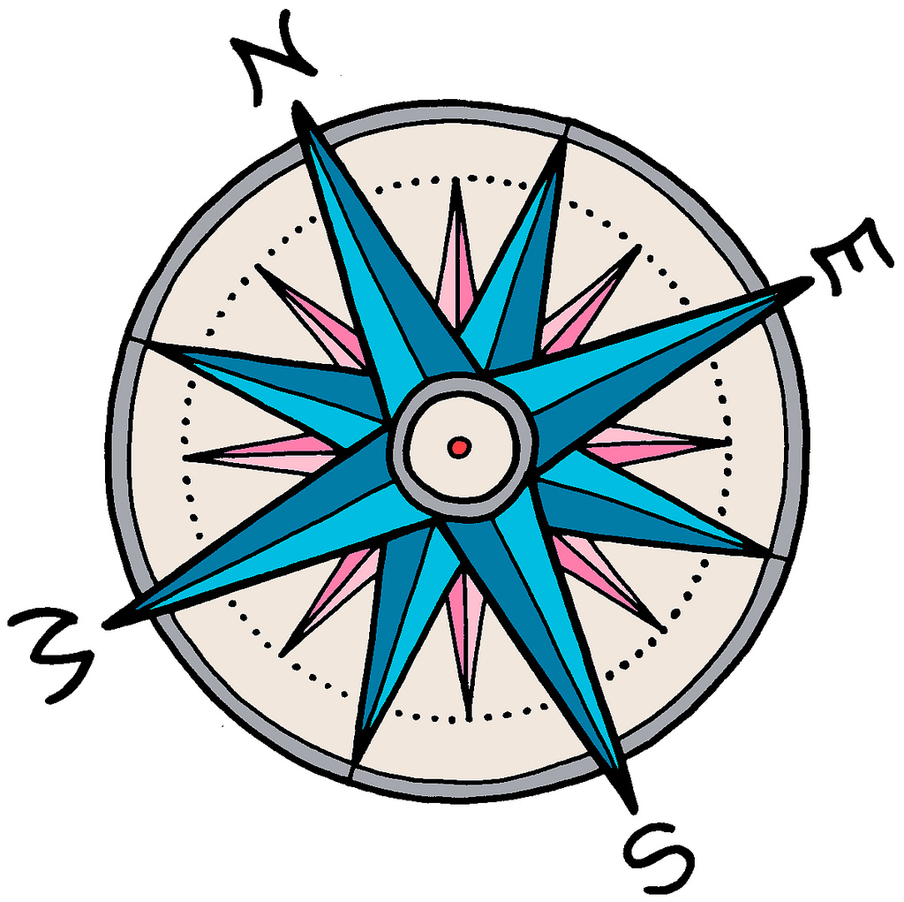
Workshop overview
Defining & redefining transfer success
NC Advising & Student Support Framework
Lessons from TAC & Aspen Institute
Best practices in advising & student support
Transfer success in your institution’s context

Slide 4

NCCCS Definition of Student Success
Student Success Pathway
Students make informed decisions.
Students progress through effective learning pathways that lead to valuable credentials, without unnecessary detours.
Students are provided integrated, targeted supports and interventions when they are most effective.
Dr. Lisa Chapman
NCCCS Executive VP/CAO
Roadmap to completion that includes
connected courses, programs, and support services
Notes:
how teachers can not only improve their expertise in their fields, but also develop their pedagogical expertise
---what does this mean to you??
Any conflicting emotions or thoughts?
Higher Ed today

Slide 5

NC Guided Pathways to Success (NC-GPS)*
integrated, institution-wide approach to creating highly structured student experiences that guide them on the pathway to completion
*Based on the AACC Guided Pathways framework

Slide 6

NC-GPS: Coordinate 1
Clarify paths to student end goals

Slide 7

NC-GPS: Coordinate 2
Help students choose and enter a pathway

Slide 8

NC-GPS: Coordinate 3
Help students stay on path

Slide 9

NC-GPS: Coordinate 4
Ensure that students are learning

Slide 10

Defining transfer success in NC

Slide 11


NC Advising & Student Support Redesign
Daniel Alvarado
Associate Director, Student Support Services, NC Community College System
Team Leader, NC Advising & Student Support Redesign Project

Slide 12

Advising & Transfer Success
Wesley Beddard
Associate VP for Programs, NC Community College System
Stephanie Bailey
Director, Community College Partnerships, UNC System

Slide 13


15-minute break

Slide 14
15-minute break

Slide 15

Transfer Success
for
Plan

Slide 16

Lunch & table discussion
What’s an insight about advising and transfer success that you have learned from a student or a colleague?
We’ll share examples at 12:45.

Slide 17
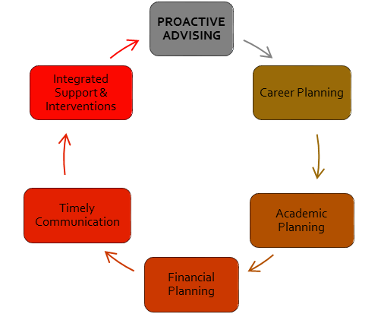

Slide 18
Essential Practices for transfer success
Prioritize transfer student success
Create clear program pathways aligned with high-quality instruction
Provide tailored transfer student advising
Build strong transfer partnerships

