Slide 1
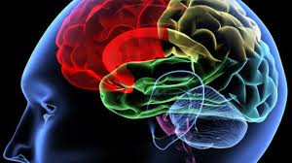
Implementing Brain Research and Classroom Teaching
                NCCCS CTE Faculty Institute
                November 8, 2018
                Dr. Mary Olvera

Slide 2
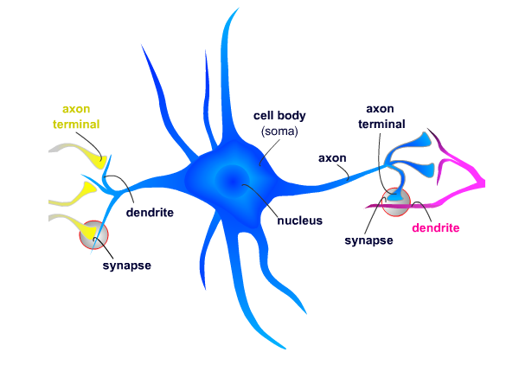
How the Brain Works
Brain cells (neurons) are the basic building blocks of the brain.
Each neuron can form up to 15,000 connections or synapses.
Electrical impulses within the cell body of the neuron are caused by interaction with the environment.

Slide 3
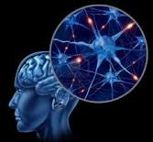
How the Brain Works
When a neural pathway is stimulated by a sensory experience, all the synapses on that pathway receive and store a chemical signal. Once the same pathway has been activated repeatedly, that pathway strengthens and will become exempt from elimination. These pathways become permanent throughout adulthood. Pathways that are not used will eventually go through a pruning process and are eliminated.

Slide 4
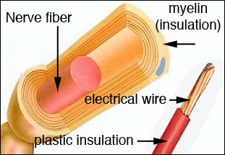
How the Brain Works
Experiences with the environment
determine how the brain is actually “wired”
The more connections the brain makes, the better and faster it will be at assimilating new information, solving problems, and thinking.
“When experiences and learning have created efficient neural pathways, signals travel easily among them and processing information requires relatively little effort” (Shore, 1997).

Slide 5
Critical Periods
There are critical periods in which certain development and learning takes place that are often called “windows of opportunity”.
Examples:
  A child is born with a cataract and it is not removed, the neural pathways for vision will not be stimulated to form the appropriate connections for vision. Without these connections, the child will become permanently blind.
  According to Dr. Patricia Kuhl, University of Washington, “newborns are prewired to recognize every sound in the every human language. They lose this capacity over the first year of life, maintaining recognition only for those sounds they are exposed to. For example, Japanese infants distinguish between “l” and “r” at birth, by nine months of age, they lose this ability” (Blackman, 2002, p.5).
  When a second language is learned by age ten, it is stored in the same area of the brain as the child’s native language. After the age of ten, learning a second language is more challenging because it must be stored in an area that is less sufficient for performing the task.

Slide 6
Neuroplasticity
A disruption in brain development can occur for many reasons. Research has found evidence that in such cases the brain will attempt to self-correct.
Neuroplasticity makes it possible for the brain to compensate for some kinds of damage and gives it the ability to develop and change in response to the environment. Neuroplasticity decreases with age.

Slide 7
Neuroplasticity
Poor cognitive and physical development is common in children that are abused and neglected. By the age of three these effects are likely to become permanent. However, these signs have proved to be reversible when the environment and adult interactions are changed early (Nash, 1997).
Because children are more proficient at making new brain connections than adults, early intervention and education are the best prescription for disadvantaged children and children with special needs (Seita, 2002).

Slide 8
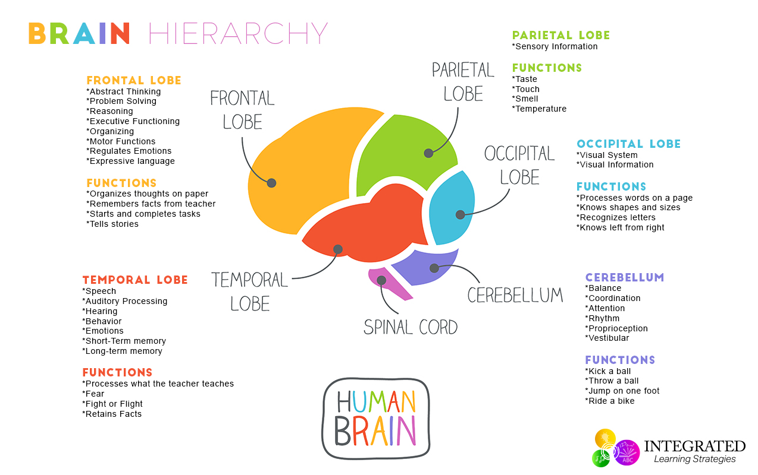
Functions of the Brain

Slide 9
Wiring for Academics: Reading
Reading skills begin in infancy with learning sounds
Skills develop on a continuum (sounds, phonological awareness, letter recognition, vocabulary, comprehension, decoding)
Uses multiple areas of the brain
  Temporal lobe- phonological awareness, decoding
  Frontal lobe- speech, language comprehension
  Right and left brain must communicate
Accesses several white matter pathways for the reading process
To read and comprehend, efficiently, you need SMOOTH pathways!

Slide 10
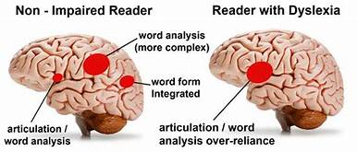
Reading Brain

Slide 11
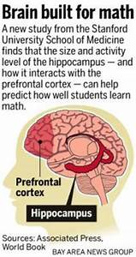
Wiring for Academics: Math
Uses on 3 regions of the brain
  Posterior parietal cortex
  Ventrotemporal occipital cortex
  Prefrontal cortex
Success depends on how well those
regions network together!

Slide 12
Affects on Brain Development
Stress:
  Prolonged exposure to stress, abuse, or trauma can actually alter brain functions
  Stress causes the chemical, cortisol, to be produced in the brain.
  Excess cortisol can destroy brain cells and decrease synaptic density in some parts of the brain. It can lead to problems with memory and self-regulation.
  Toxic Stress: Chronically high levels of cortisol have been associated with some developmental delays and neurological impairments.

Slide 13
Affects on Brain Development
Movement:
  According to Jean Blaydes, neurokinesiologist, “what makes us move, makes us think” .
    Helps balance brain chemicals that calm behavior and elevate self-esteem
    Increases neurons ability to communicate
    Increases the blood flow to the brain which in turn increases oxygen and glucose levels.
  When a person sits for more than 20 minutes, blood pools in their seat and feet. Just standing up will increase the blood flow, and it only takes standing for 45 seconds to increase the blood flow to the brain by 15% .
  Movements that cross the midline of the body, cause the right and left brain to communicate optimizing development.

Slide 14
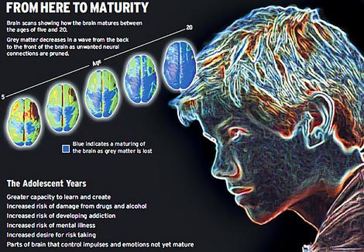
Age differences in Brain development
“Virtually all the world’s cultures recognize adolescence as a distinct period in which adolescents prefer novelty, excitement, and peers. This near-universal recognition sinks the notion that it’s a cultural construct.” (Dobbs, 2011)
Frustrations, anyone?

Slide 15
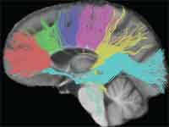
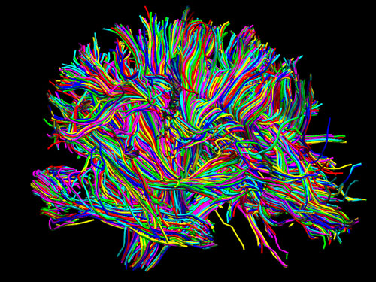
GREy Matter Versus White matter
Grey Matter
Controlled by nerve cell bodies
Majority of true dendrite
No extended axons
Has no myelin
White Matter
Compose the structures at the center of the brain
Controls functions that we are not aware of
Has myelin

Slide 16
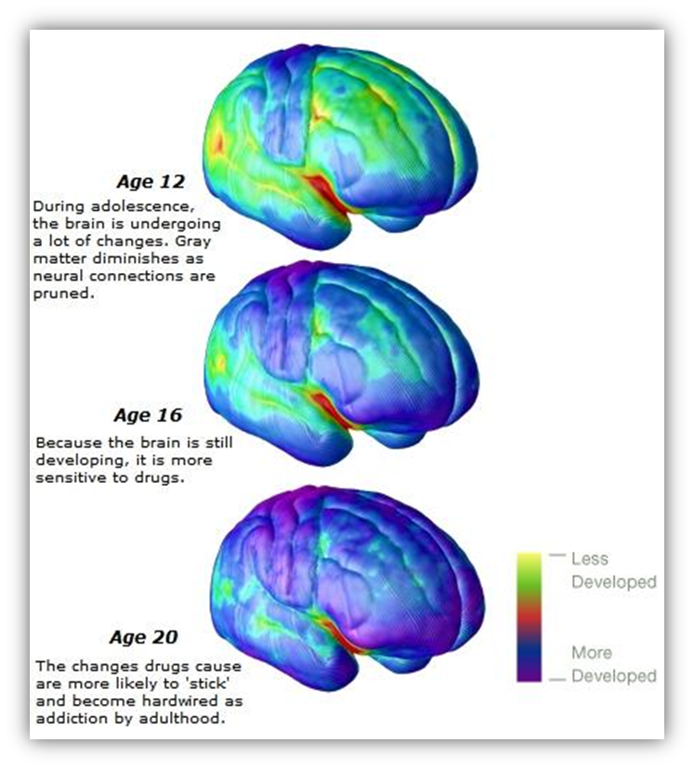
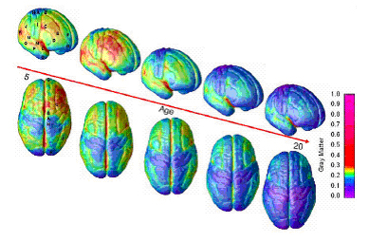
Time Lapse Imaging of Brain Maturation

Slide 17
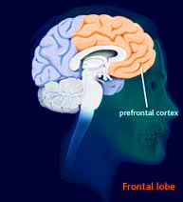
Prefrontal cortex
Uses 1/3 of the daily calorie intake consumed.
For individuals under 25 years old, the prefrontal cortex is not fully developed.
Individuals under 25 will often make inconsistent decisions and take un-necessary risks.

Slide 18
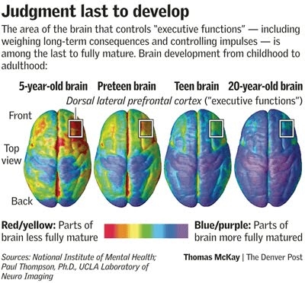
What are they thinking?

Slide 19
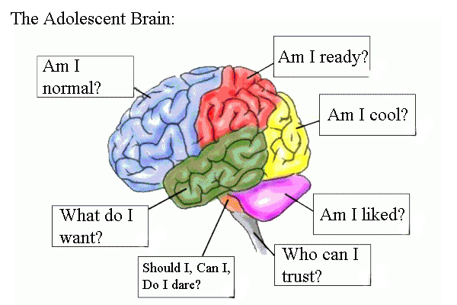
Stage 5: Identity vs. Role Confusion
Ages 12-18
Form ego identity: self-image
Strong sense of identity: face adulthood with certainty and confidence
Identity crisis: confusion of ego identity

Slide 20

Shifting the paradigm
THEN:
Hormonal Risk takers
Irrational Unmotivated
Irresponsible Stubborn
Struggling learners Unprepared
Not ready Unorganized
Immature Rebellious
Dramatic Emotional
NOW:
Emotional intensity
Social engagement
Novelty
Creativity

Slide 21
Why Shift?
The National Institutes of Health (NIH) project established that “brains undergo a massive reorganization between our 12th and 25th years” (Dobbs, 2011, p. 2)
Siegel (2013) stated “What others believe about us can shape how we see ourselves and how we behave” (p. 3). “
“Adolescents who are absorbing negative messages about who they are and what is expected of them may sink to that level instead of realizing their true potential” (Siegel, 2013, p. 4).
Words actually have the ability to physically alter the brain. Teachers must choose their words carefully because words can raise spirits and generate motivation in a way that is biochemical, similar to medication (Sheffeld, 1996).

Slide 22
The Essence of the adolescent mind
ES- Emotional Spark
Intense internal sensations that serve to create meaning and vitality
SE- Social Engagement
Connections that support our journey through life with meaningful, mutually rewarding relationships
N-Novelty
Seek out and create new experiences to fully engage through emotions, thinking and body in new challenging ways
CE- Creative Expressions
Conceptual thinking, abstract reasoning and expanded consciousness creating a gateway to seeing the world through new lenses

Slide 23
The Essence of the adolescent mind
Adol-ESSENCE
Emotional Spark
Social Engagement
Novelty
Creative Exploration
Adult-ESSENCE

Slide 24
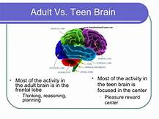
Adult vs adolescent

Slide 25

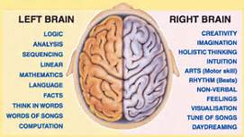
Right brain vs Left brain
Males have more connections within hemispheres
Females have more connections between hemispheres
Males connect more front to back
Females connect more left to right

Slide 26
Male vs. Female
Brain | Function | Size
Amygdala | Basic Emotion | Larger in males
Cingulate gyrus | Emotion, learning and memory | Larger in females
Hippocampus | Learning and Memory | Larger in females
Hypothalamus | Hunger, thirst, Sex | Larger in males
Inferior temporal gyrus | Form and color perception | Larger in males
Lingual gyrus | Vision and dreaming | Larger in females
Prefrontal cortex | Problem solving complex movements | No difference
Thalamus | Connection between brain regions | No difference
Corpus collosum | Communication between hemispheres | Thicker in females
Frontal lobe | Social cognition, judgement | Larger in females

Slide 27
Break for Part II!
Brain Break
Move
Eat
Visit the Sunlight

Slide 28
Brain-based Learning
The brain is motivated and activated when experiences are meaningful, relevant and interesting.
The brain has been making connections since birth, seeks out patterns and connections to make sense of the world.
Best Practices for the Brain
Active engagement
Safe learning environment
Real-world learning
Relevant

Slide 29
Role of the Teacher
  Facilitator of Learning
  No longer the “source of all knowledge” in the classroom
  Motivator
  Inspirer
  Encourager
ENGAGE ME!!

Slide 30
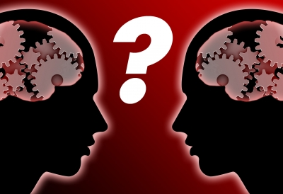
Teacher as facilitator
“The teachable moment occurs in their minds, not in mine. When you move from teacher to facilitator you leverage the shared experiences and wisdom of your learners to provide an environment where applied and “real” learning can take place.” - Michael Sunnarborg

Slide 31
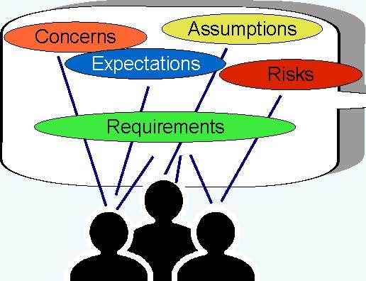
Best Practices for facilitation
Begin by asking questions. Find out who your learners are — what is their background and level of knowledge and experience with the topic?
Introduce information in a interesting way. Be creative and enthusiastic in your presentation of information.
Make the content applicable. Ask students to apply the content to their current environment. Access prior knowledge to make connections.
Learners as Teachers. Effectively leverage the knowledge and experience of your learners to help them teach each other.

Slide 32
What Does the Research Say?
One research study concluded that many students feel no real connection to their learning. To be the most effective, it is important to mix relevance with rigor.

Slide 33
Retention
  Retention will increase when activities are meaningful, interesting, and relevant.
  Retention is also increased when more than one sense is involved in experiences, requiring teachers to facilitate a multi-sensory, hands-on approach.
  Research reveals that emotion increases retention (Glenn, 2002). Teachers should be enthusiastic about teaching so that children perceive learning as a pleasurable experience.
  Encourage students to teach others what they have learned. When someone teaches another person, retention increases by as much as 400%.
  Most importantly remember that humor increases learning. Research indicates “Humor can increase retention from 15% to 50%” (Glenn, 2002).
  When someone laughs it increases blood flow to the brain and releases endorphins (Glenn, 2002).

Slide 34
brain based learning
Purposely using strategies based on how the brain works.
All learning enters our brain through our senses. Students that are anxious, stressed, or have not had their basic needs met, struggle with learning.
“Brain-based education is actually a “no-brainer.” Here’s a simple, but essential premise: the brain is intimately involved in, and connected with, everything educators and students do at school. Any disconnect is a recipe for frustration and potentially disaster. Brain-based education is best understood in three words: engagement, strategies and principles.” –Eric Jensen

Slide 35
Principles of brain based learning
Encourage movement
Create appropriate social learning opportunities
The brain changes. Use strategies to increase student capacity.
Create a safe, low-stress environment
Teach in smaller chunks. Allow time for processing.
Allow students to be creative. Creativity boosts attention and working memory.
As you address soft skills, foster emotional intelligence. Only six emotions are hard wired from birth, the rest are influenced through learned behaviors and reinforcement.
Help students develop intentional memory and recall strategies.

Slide 36
What strategies do you use that are brain friendly?

