Slide 1

The Hero’s
Journey
NC Community Colleges
Creating Success
Frank Scuiletti, Ed.D.
Construction, Engineering, Industrial, Transport Technologies & Work-Based
Learning
Notes:
It’s fitting, isn’t it, that it is you who has committed yourself to this journey? The student, has become the teacher, has become the student. Life is one long journey, for those who are fortunate, and within that long journey there are many smaller journeys, each with it’s own beginning and end. It takes courage to slip the rope from its mooring and from what is familiar to allow the winds of destiny to fill our sails and push us toward some unknown future and unknown horizon. When out in the midst of a great ocean one can easily loose direction. There are no paths or roadways on the vast ocean, there are no road signs, there is only water surrounding us everywhere we look with no horizon in sight. There is also the uneasiness we feel regarding not knowing what lies below the dark depths that lie in wait for us. Water represents the unconsciousness and as we float along the surface we ride upon the border that separates what we know and what lies hidden and dormant within us. So, what voice whispered into our ears that we should leave the safe confines of land, our comfort zone, to seek out lands we have never before seen? Perhaps it is our hunger for knowledge, for growth, to learn about distant lands that we do not yet fully understand, to learn about ourselves and one another, and that of experiencing all there is in life to experience. And as leaders, to learn how to share the experience with others. Of course, we hope to find success.

Slide 2

We Travel on a Common Journey
Notes:
Art , literature, dance—speak a common truth about the human condition. Campbell was a professor at Sarah Lawrence College. He was famously known for his work with myth and for saying “Follow your Bliss”.

Slide 3
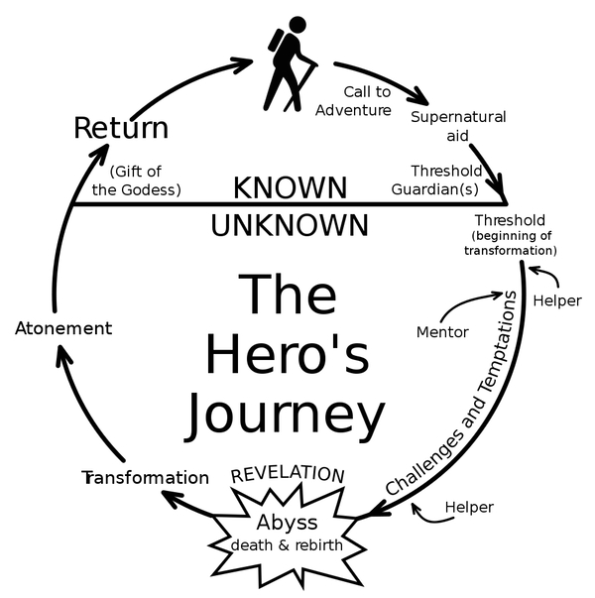
Notes:
All heroes follow a similar path.

Slide 4
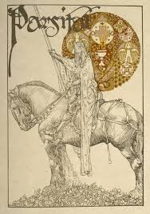
THE
HERO
Notes:
Parsifal and the search for the Holy Grail. The Knights of the Round Table. Parsifal means fool.

Slide 5

Don Quixote
Notes:
Don Quixote. What is real? Is this another telling of Parsifal? Go back to previous slide and note similarities.

Slide 6


Call to Adventure
Notes:
All men take the hero’s journey. The Hobbit, Neo (The Matrix), and Luke Skywalker (Star Wars) are modern examples of unlikely/unwilling heroes. Learn how to successfully navigate the challenges of your exciting journey through a world of high-tech careers, personality profiles, college education, personal development, and leadership. Samuel Jackson in The Avengers.

Slide 7


Notes:
Men in Black & Star Wars

Slide 8



Slide 9


Notes:
Lord of the Rings and Harry Potter.

Slide 10

The
Challenge
Notes:
How BIG does your enemy seem? Bigger than life?

Slide 11

Notes:
Our enemies know our weaknesses. Have a little fire, Scarecrow? Perhaps our enemies are within.

Slide 12

Notes:
Eye of Saruman (Lord of the Rings).

Slide 13

Notes:
Darth Vader (Star Wars). Who's your daddy?

Slide 14

Notes:
Voldemort from Harry Potter.

Slide 15

Atonement
Notes:
Success. It takes all our traits to defeat our nemesis: Courage, intelligence, heart, animal instinct, and femininity.

Slide 16
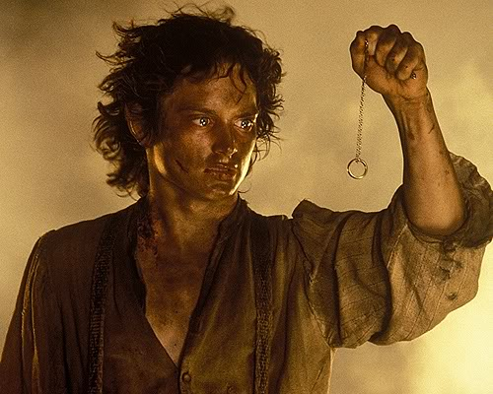
Notes:
Skills, courage, determination, grit, yet in the end we often fail. It is something we must realize about ourselves and something we must learn to be forgiven of.

Slide 17
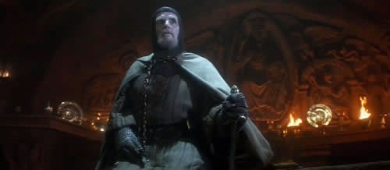
Notes:
In the end you must, ”choose wisely.” Do not let the shiny objects distract you—wisdom often comes in a form of humility (the wooden cup).

Slide 18

Notes:
We need the assistance of others to be successful. There is good in everyone.

Slide 19

Which Direction to Take?
Notes:
It is much more difficult to look forward into the future (students) than to look back over the past (teachers/mentors).

Slide 20

Outfitting the Hero. No Swords Allowed.
Skills?
Luck?
Persistence?
Intelligence?
Courage?
Notes:
Is success predictable?

Slide 21
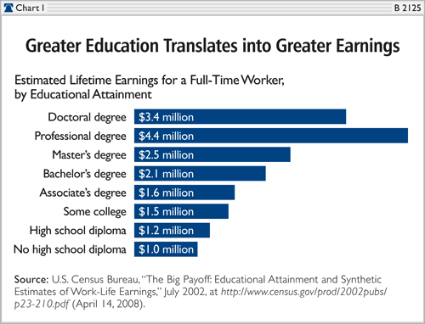

Notes:
Many gender-specific CTE programs. Low male educational program numbers. Myers-Briggs Personality Indicators: Men: 75% analytical; Women 25%; Women 75% feeling; Men 25%. Similar by design but with certain specific differences.

Slide 22
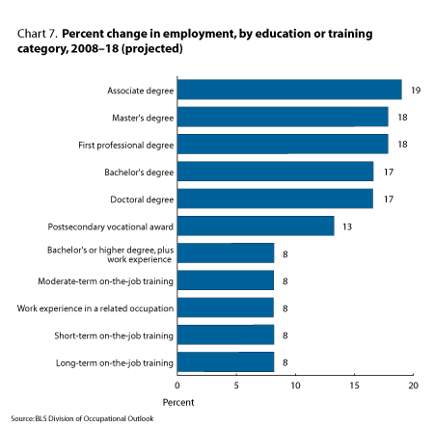
Notes:
In general, occupations in a category with some postsecondary education are expected to experience higher rates of growth than those in an on-the-job training category. Traditional inventions with added electronics.

Slide 23
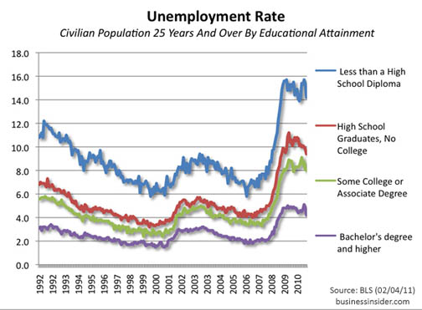
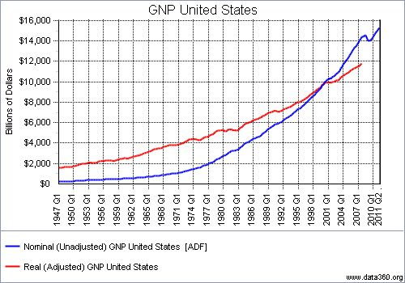
Notes:
Flatter lines for higher education. Doctorate equates to approximately 2-3% of U.S. population. RTP highest ed level in U.S.. Higher skills: Fewer jobs but even fewer qualified applicants. Lower skills: everyone is capable. Analogy: Affording a “cheap” 1972 VW, Pinto and Vega ($2,000). GNP keeps growing even with less industry. Expensive homes, vehicles, televisions, computers, etc.

Slide 25

Notes:
U of Texas, Austin. Business informatics or analytics. Data mining. 400 applications and 52 spots. The average Graduate Management Admission Test (GMAT) was 710, the highest of any graduate school in the school of business. How important it is for us to set the course for a final destination that is based on a great possibility of success.

Slide 26
NCCCS Career Technical Education
Notes:
FRANK Academic Programs (Here’s what we do)
Curriculum or credit programs. We refer to non-credit programs as
occupational continuing education
Approx. 280 CTE programs under broad program titles. Associate Degree Nursing, Dental Hygiene, Phlebotomy, Computer Programming, Accounting, Entrepreneurship, Digital Effects and Animation, Electric Lineman, Motorsports Management, Computer-Integrated Machining, Basic Law Enforcement Training, Early Childhood Education, Cyber-Crime Technology, and Aviation Systems Technology.
Terminal Degrees
CTE programs incorporate both Academic and Technical Instruction
Most programs are offered as Certificate: One semester, Diploma: One year, & Associate in Applied Science: Two year
Represents 2/3 of all degree seeking students; 1/3 transfer
Comprehensive Articulation Agreement is pathway for transfer to 4-year
Bi-laterals are pathways for CTE transfer to 4-year institutions
Our goal is to provide students with the academic and technical skills necessary for employment and to provide employers with qualified individuals who possess appropriate career skills.

Slide 27
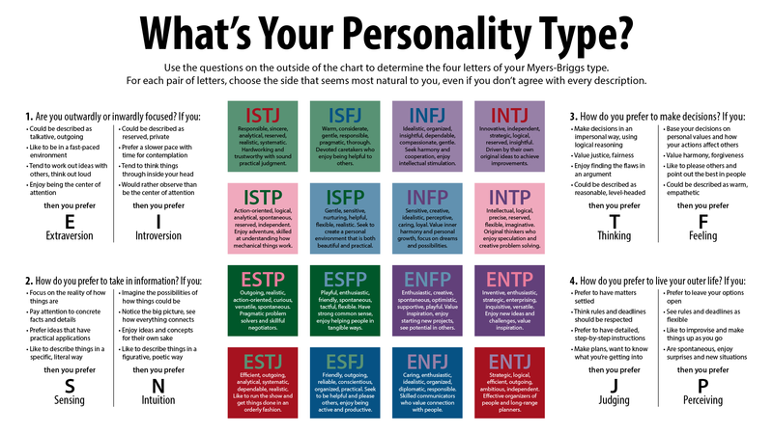

Slide 28
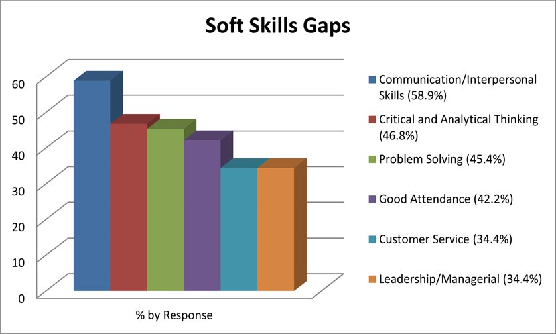

Slide 29

Return

Slide 30
References:
http://www.careerinfonet.net/
http://nces.ed.gov/
http://www.careertech.org/
http://www.dol.gov/
http://www.bls.gov/
http://www.google.com/imghp
http://www.onetonline.org/
Notes:
Thanks for watching. Created by Frank Scuiletti. 10/6/2011.

