Slide 1
Integrating Employability Skills: A Framework for All Educators

Slide 2

Welcome and Introductions

Slide 3
Implementation Tools
Implementation tools are free and customizable train-the-facilitator resources.
Implementation tools help build a common language and understanding.

Slide 4
Implementation Tools Materials
http://www.ccrscenter.org/
 | About Us | Products & Resources | Implementation Tools | Work-Based Learning | Ready for Success Blog
Presentation slides, handouts, and a facilitator’s guide Free and customizable train-the-facilitator resources

Slide 5
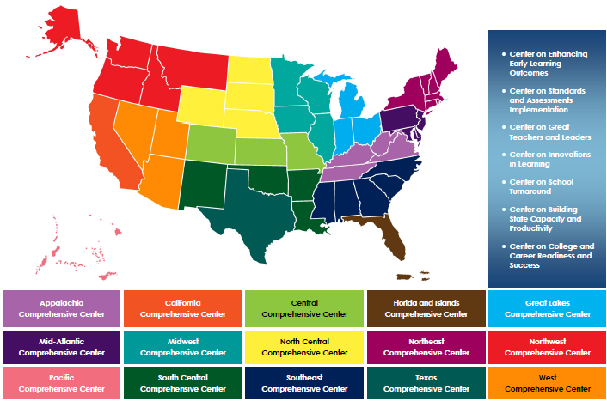
Comprehensive Centers Program
2012–19 Award Cycle

Slide 6
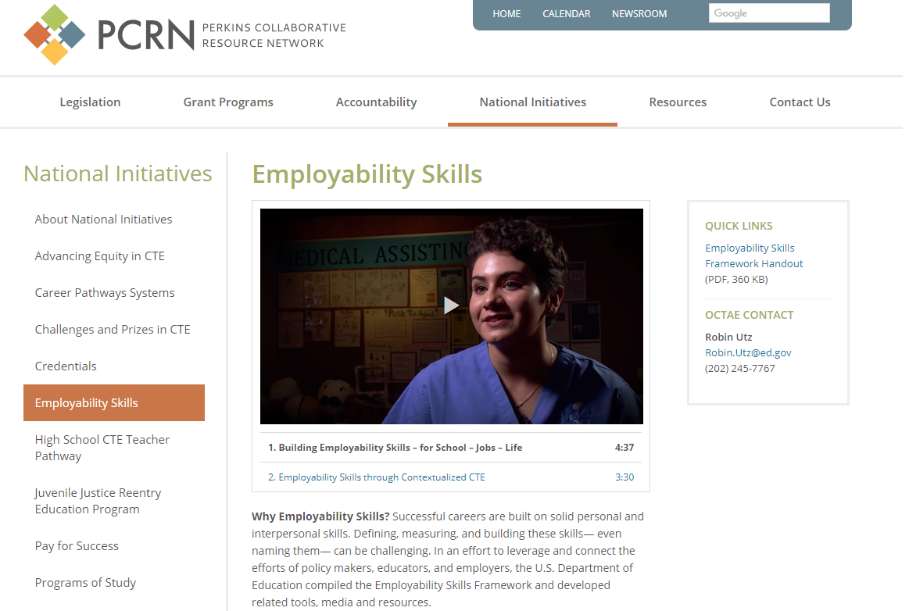
Employability Skills Framework
https://cte.ed.gov/initiatives/employability-skills-framework

Slide 7
Agenda
Review the Employability Skills Framework.
Crosswalk state college and career readiness standards with the Employability Skills Framework.
Discover how to integrate employability skills within curriculum.
Review the lesson planning tool for embedding employability skills into classroom activities.
Connect employability skills and work-based learning.

Slide 8
Objectives
Participants will do the following:
Understand what employability skills are and why they are important.
Learn strategies to prioritize and integrate employability skills in college and career readiness standards, classroom instruction, work-based learning, and professional learning.

Slide 9
What Are Employability Skills?

Slide 10
Importance of Employability Skills
Employability skills are cited as among the most important skills by employers (Hart Research Associates, 2015).
A lack of employability skills may contribute to a “talent shortage” (ManpowerGroup, 2012).
The demonstration of employability skills is correlated with better hiring rates, success on the job, and earnings (Lippman et al., 2015).

Slide 11
Activity 1: What Are
Employability Skills?
When you hear the term employability skills, what are some of the terms that come to mind?

Slide 12

Defining Employability Skills
Employability skills are the general skills and knowledge that are necessary for success in the labor market at all employment levels and in all sectors.

Slide 13
Activity 2: Identifying
Employability Skills
Brainstorm activity:
On your own, generate a list of your top five most important employability skills.
Record each skill on a sticky note.
Discuss your list with your table.
Remove duplicate skills.

Slide 14
Activity 3: Categorizing
Employability Skills
Referencing your table’s sticky notes, where would you place your employability skills?
  Effective relationships
  Workplace skills
  Applied knowledge
Discuss with your table.
Place your sticky notes on the appropriate chart paper.

Slide 15
Activity 2: Identifying
Employability Skills
On your own, generate a list of your top 5–10 most important employability skills.
Record each skill on the top of Handout A.
Referencing your list, place each skill into one of the three categories of employability skills.
Effective Relationships | Workplace Skills | Applied Knowledge
Recategorized Skills

Slide 16
Employability Skills Framework
The skills that enable individuals to interact effectively with clients, coworkers, and supervisors
The thoughtful integration of academic knowledge and technical skills, put to practical use in the workplace
The skills employees need to successfully perform work tasks

Slide 17
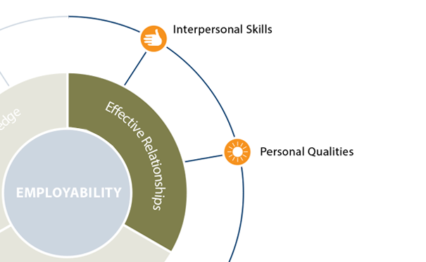
Effective Relationships
  Understands teamwork and works with others
  Responds to customer needs
  Exercises leadership
  Negotiates to resolve conflicts
  Respects individual differences

Slide 18
Effective Relationships
  Demonstrates responsibility and self-discipline
  Adapts and shows flexibility
  Works independently
  Demonstrates a willingness to learn
  Demonstrates integrity
  Demonstrates professionalism
  Takes initiative
  Displays positive attitude and sense of self-worth
  Takes responsibility for professional growth

Slide 19
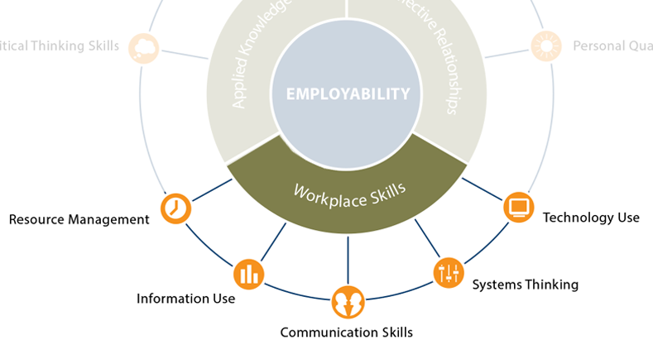
Workplace Skills
  Manages time
  Manages money
  Manages materials
  Manages personnel

Slide 20
Workplace Skills
  Locates information
  Organizes information
  Uses information
  Analyzes information
  Communicates information

Slide 21
Workplace Skills
  Communicates verbally
  Listens actively
  Comprehends written material
  Conveys information in writing
  Observes carefully

Slide 22
Workplace Skills
  Understands and uses systems
  Monitors systems
  Improves systems

Slide 23
Workplace Skills
  Understands and uses technology

Slide 24
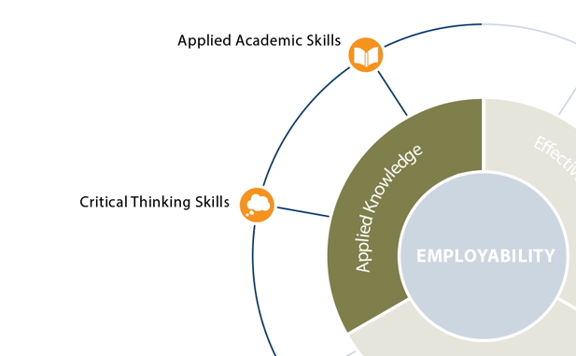
Applied Knowledge
  Uses reading skills
  Uses writing skills
  Uses mathematical strategies and procedures
  Uses scientific principles and procedures

Slide 25
Applied Knowledge
  Thinks critically
  Thinks creatively
  Makes sound decisions
  Solves problems
  Reasons
  Plans and organizes

Slide 26
Identifying Employability Skills
Revise your categorization of employability skills based on this additional information.
Effective Relationships | Workplace Skills | Applied Knowledge
Recategorized Skills
20

Slide 27
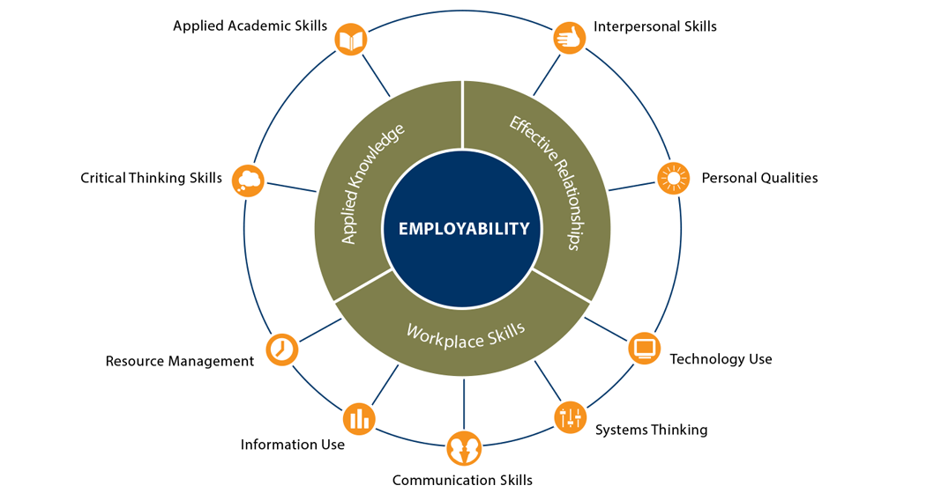
Employability Skills Framework
21

Slide 28
How to Integrate Employability Skills: Standards
22

Slide 29

Integrating Employability Skills
Integrate employability skills purposefully and strategically
Opportunities to integrate employability skills in:
  Standards
  Curriculum
  Classroom instruction
  Work-based learning
23

Slide 30
College and Career Readiness Standards
State college and career readiness standards
  Represent what students must know and be able to do at each grade level to be college and career ready
  Standards for mathematics and English language arts (ELA)
  Tailored to state context
Common Career Technical Core (CCTC) developed by
Advance CTE
  Includes a set of technical skill standards for 16 career clusters as well as career readiness practices common to all clusters
Social and Emotional Learning (SEL)
  Competencies that describe the process through which people understand and manage emotions and maintain positive relationships
24

Slide 31
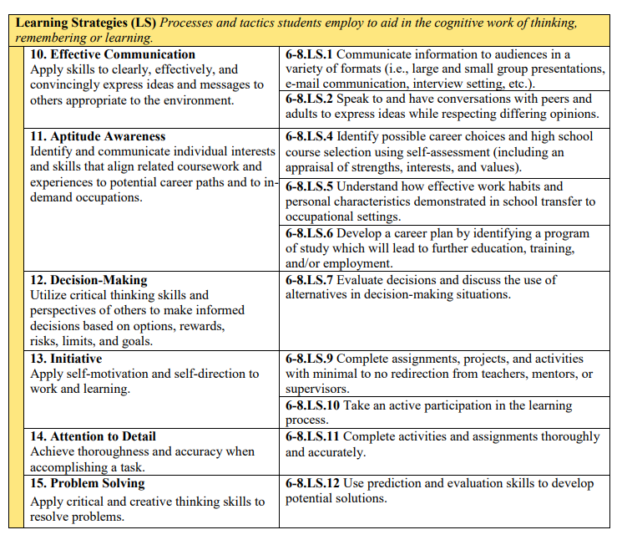
Example in Practice: Indiana
Source: Indiana Department of Education (2019), p. 2
25

Slide 32
Sample Crosswalk Language
Critical Thinking Skills
Thinks critically
Thinks creatively
Makes sound decisions
Solves problems
Reasons
Plans and organizes
Common Core
ELA Anchor Standards
  CCSS.ELA-LITERACY.CCRA.R.1: Read closely to determine what the text says explicitly and to make logical inferences from it; cite specific evidence…
  to support conclusions drawn from the text.
  CCSS.ELA-LITERACY.CCRA.SL.4: Present information, findings, and supporting evidence such that listeners can follow the line of reasoning and the organization, development and style are appropriate to the task, purpose and audience.
Mathematics Anchor Standards
  CCSS.MATH.PRACTICE.MP2: Reason abstractly
  and quantitatively.
  CCSS.MATH.PRACTICE.MP3: Construct viable arguments and critique the reasoning of others.
26

Slide 33
Sample Crosswalk Language
Critical Thinking Skills
Thinks critically
Thinks creatively
Makes sound decisions
Solves problems
Reasons
Plans and organizes
CCTC
Career Ready Practice 8. Utilize critical thinking to make sense of problems and persevere in solving them.
27

Slide 34
Sample Crosswalk Language
Critical Thinking Skills
Thinks critically
Thinks creatively
Makes sound decisions
Solves problems
Reasons
Plans and organizes
SEL
Responsible decision making: Make constructive choices about personal behavior and social interactions based on ethical standards, safety, and social norms.
28
Notes:
https://casel.org/what-is-sel/

Slide 35
Crosswalk With College and Career Readiness Standards
Employability Skills |  | State CCR Standards | CCTC | SEL
Applied Knowledge | Applied Academic Skills | X | X
 | Critical Thinking Skills | X | X | X
Effective Relationships | Interpersonal Skills | X | X | X
 | Personal Qualities |  | X | X
Workplace Skills | Resource Management
 | Information Use | X | X
 | Communication Skills | X | X | X
 | Systems Thinking |  | X | X
 | Technology Use | X | X
29
Notes:
https://casel.org/what-is-sel/

Slide 36
Crosswalk With College and Career Readiness Standards
Employability Skills |  | State CCR Standards
Applied Knowledge | Applied Academic Skills
 | Critical Thinking Skills
Effective Relationships | Interpersonal Skills
 | Personal Qualities
Workplace Skills | Resource Management
 | Information Use
 | Communication Skills
 | Systems Thinking
 | Technology Use
30
Notes:
https://casel.org/what-is-sel/

Slide 37
Activity 4: Employability Skills Crosswalk and Planning Workbook
Review your college and career readiness standards.
Complete the workbook:
  Review selected standards or performance criteria for evidence of explicit or implicit alignment with each of the skills and skill components in the Employability Skills Framework.
  Summarize alignment findings across all standards.
  Identify immediate next steps and long-term goals.
Plan for next steps and complete action planning.
31

Slide 38
Critical Thinking Skills
Employability Skills in This Category | Alignment to Standard or Performance Criteria
 | Explicit (does not require an inference beyond the description) | Implicit (requires some inference beyond the description) | Great | Minimal | None
Thinks Creatively: Students create innovative and novel ideas or solutions and display divergent thinking. This thinking can be seen in oral presentations, creative-writing assignments, open-ended tasks, and project design.
Thinks Critically: Students display analytical and strategic thinking. This thinking can be seen in debating an issue, converging on an understanding, assessing a problem, and questioning (e.g., playing devil’s advocate).
Makes Sound Decisions: Students differentiate between multiple approaches and assess options.
Solves Problems: Students assess problems involving the use of available resources (i.e., personnel and materials) and review multiple strategies for resolving problems.
Reasons: Students negotiate pros and cons of ideas, approaches, and solutions and analyze options using an “if-then” rationale.
Plans and Organizes: Students plan steps, procedures, or approaches for addressing tasks. This planning occurs naturally in most assignments, ranging from solving one problem to completing long-term projects in mathematics and science classes.
Reflections on Explicit and Implicit Alignment:
32

Slide 39
How to Integrate Employability Skills: Curriculum
33

Slide 40
Standards Are Important but Insufficient
Standards are important but Insufficient
To be effective in improving education and getting all students ready for college, workforce training, and life, the standards must be partnered with a content-rich curriculum and robust assessments, both aligned to the standards.
34

Slide 41


How to Emphasize Employability Skills in Curriculum
  Identify connections between employability skills and academic content in the curriculum design process.
  Use curriculum maps to help find connections.
35

Slide 42
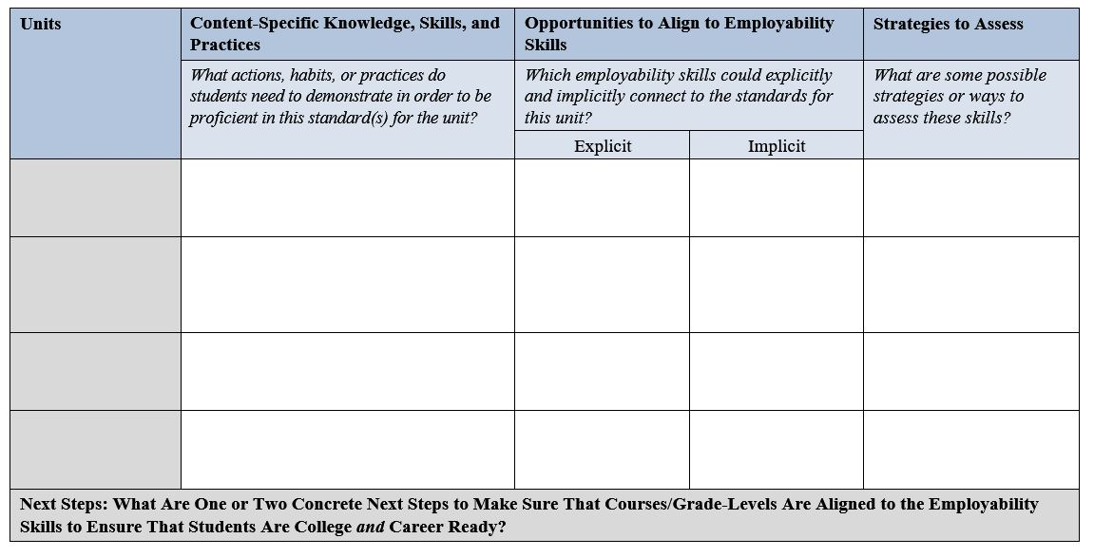
Activity 5: Curriculum Planning Tool
36

Slide 43
How to Integrate Employability Skills: Classroom Instruction
37

Slide 44
Employability Skills in the Classroom
All teachers can emphasize employability skills across all grade levels.
Many teacher lessons already support the development of these skills:
  Project-based learning
  Labs
  Developing skills, such communication, collaboration, and so forth
38

Slide 45


How to Emphasize Employability Skills in Classroom Instruction
  Identify the most applicable employability skills and integrate those skills into instruction. Monitor the depth and breadth of skills in lessons.
  Share what employability skills are and why they are important to call attention to as they are being taught to students.
  Help students communicate their own employability skills to employers.
39

Slide 46
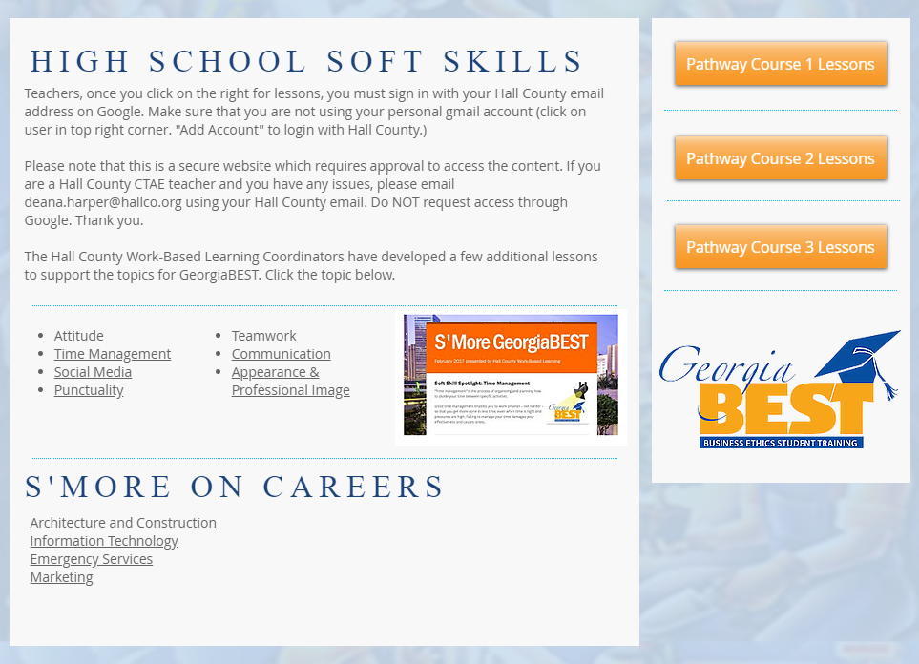
Example in Practice: Georgia
https://www.hallcowbl.org/copy-of-wbl-ga-best
40

Slide 47
Activity 6: Employability Skill and Instruction Matching Activity
Read through the instructional techniques or models on Handout D.
Match the instructional techniques or models to the employability skills they support.
Discuss with your group.
41

Slide 48
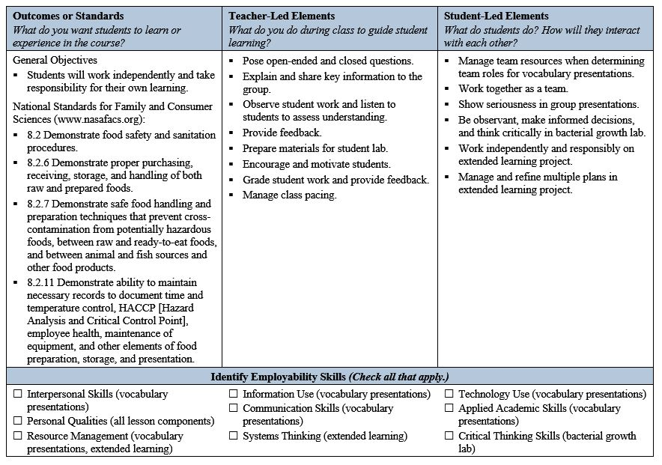
Formative Lesson Planning Tool
42

Slide 49
Activity 7: Lesson Planning
Review Handout F: Formative Lesson Planning Tool for Integrating Employability Skills Into Practice (Career Technical Education [CTE] Sample).
Identify connections between the standards, teacher-led activities, student-led activities, and employability skills.
Discuss these connections with your colleagues.
43

Slide 50
Activity 7: Lesson Planning
Read through the introduction to Handout G: Formative Lesson Planning Tool for Integrating Employability Skills Into Practice (English Language Arts [ELA] Activity Template).
Identify at least three teacher-led activities in which the teacher can model or teach specific employability skills.
Identify at least three student-led activities in which students can practice or demonstrate specific employability skills.
Write down the specific employability skills in the second row of the handout.
44

Slide 51
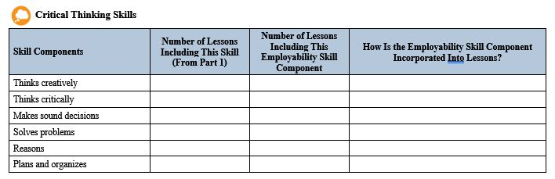
Summative Lesson Planning
Self-Reflection Tool
45

Slide 52
Action Planning and Next Steps
What is the breadth and depth of the employability skills that are embedded in your instructional practice?
In what ways can you strategically embed these skills across your grade level or content area?
What can you do to ensure that employability skills are being reinforced in the classroom?
46

Slide 53
How to Integrate Employability Skills: Work-Based Learning
47

Slide 54
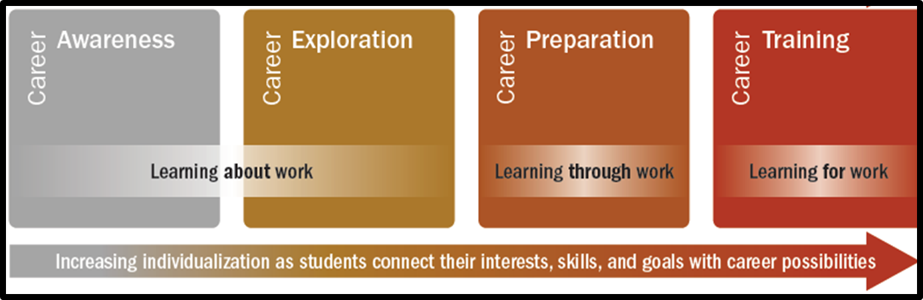
What Is Work-Based Learning?
48

Slide 55
Where to Emphasize Employability Skills Development
Measuring student learning from work-based learning experiences:
  Rubrics
  Portfolios
  Employer evaluation forms
  Student self-assessments
Training plans with students:
  Students plan with employers and educators which skills to develop during a work-based learning experience
49

Slide 56
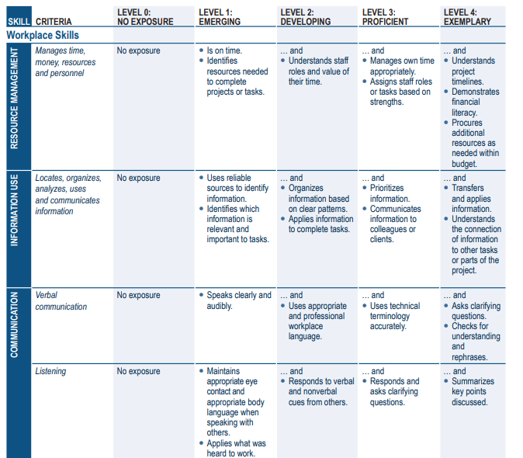
Example in Practice: Kansas
Source: Kansas State Department of Education (2018), p. 14.
50

Slide 57
Activity 8: Scenarios for Business: Employability Skills
Individually read the assigned scenario.
Discuss the scenario in your breakout groups and answer the questions in the template:
  Outcomes and standards (students)
  Staff- and employer-led elements
  Student-led elements
  Employability skills
  Communication and engagement with school or youth program
Place responses on chart paper.
Select a reporter and share out with the larger group.
51

Slide 58
Activity 9: Scenarios for Business: Self-Reflection
Identify an activity or program initiative conducted by business or industry that engages students.
Discuss the activity or initiative in your breakout groups and answer the questions in the template:
  Outcomes and standards (students)
  Staff- and employer-led elements
  Student-led elements
  Employability skills
  Communication and engagement with school or youth program
Place responses on chart paper.
Select a reporter and share out with the larger group
52

Slide 59
Resources
53

Slide 60
Employability Skills Framework Website
One-stop resource for information on employability skills for instructors, administrators, employers, and students
Key content:
  Interactive Skills Framework
  Assessment Comparison Worksheet
  Lesson Planning Checklist
Access audience-specific landing pages
http://cte.ed.gov/employabilityskills/index.php/framework/
54

Slide 61
CCRS Center Website
Free resources, trainings, briefs, and guides available on a variety of education topics
Key content:
  College and career readiness
  Work-based learning
Access to experienced technical assistance providers who can work in close partnership with state education agency staff
www.ccrscenter.org
55

Slide 62
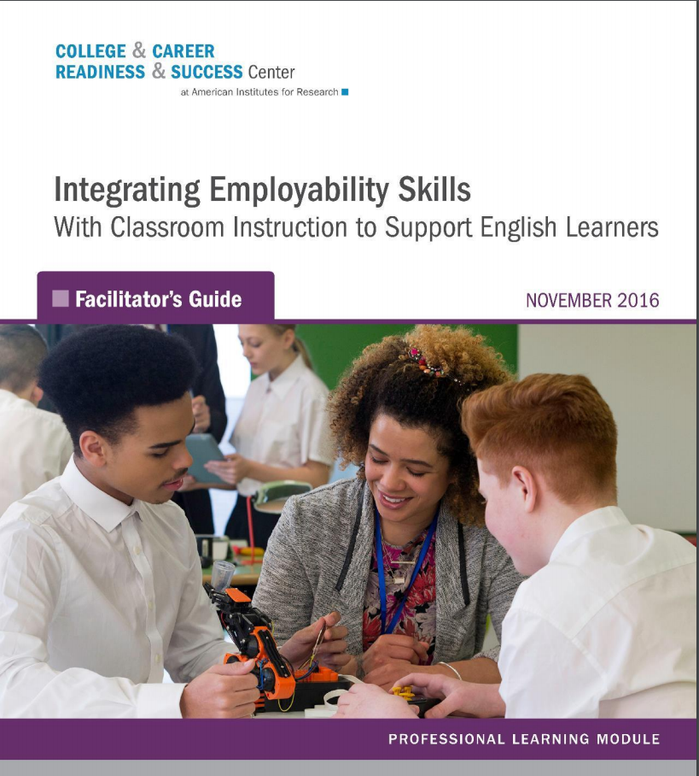
Integrating Employability Skills With Classroom Instruction to Support English Learners
How do you attend to the specific needs and cultural nuances to develop employability skills for English learners?
Key content:
  Interactive module that includes slides, handouts, and facilitator’s guide
  Discusses how to differentiate instruction of employability skills to English learners
http://www.ccrscenter.org/technical-assistance-networks/professional-learning-modules/employability-skills-English-learners
56

Slide 63
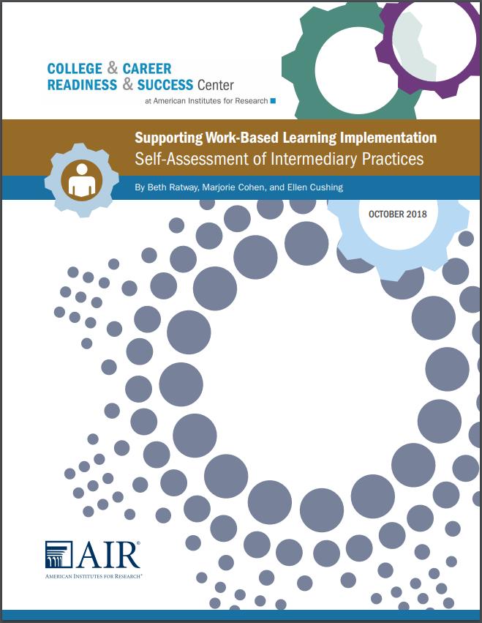
Supporting Work-Based Learning Implementation Self-Assessment of Intermediary Practices
How do you ensure that states have robust intermediary strategies that can support work-based learning?
Key content:
  Self-assessment organized in five core elements crucial for quality intermediaries
  States and districts can self-assess their progress across three stages of implementation
http://www.ccrscenter.org/sites/default/files/WorkBasedLearning_Intermediaries_Self-Assessment.pdf
57

Slide 64
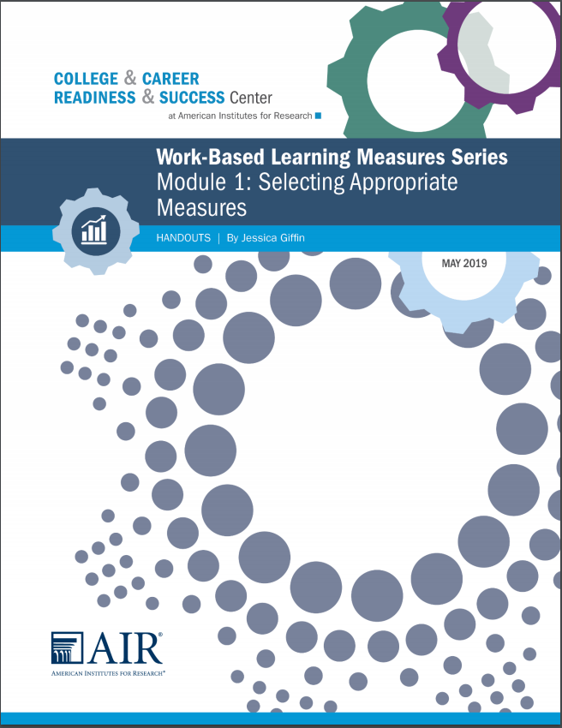
Work-Based Learning Measures Series
How do you measure what students learn from their work-based learning experiences?
Key content:
  Five-part module series helps you select an appropriate work-based learning measure
  Additional modules outline the key steps to developing portfolios, rubrics, employer evaluations, and student self-assessments for work-based learning
http://www.ccrscenter.org/technical-assistance-networks/professional-learning-modules/work-based-learning-measures-series
58

Slide 65

Developing a College- and Career-Ready Workforce: An Analysis of ESSA, Perkins V, IDEA, and WIOA
How can states develop a coherent approach to ensuring that all students are prepared for tomorrow’s careers and workforce demands?
Key content:
  Helps identify opportunities to align and leverage policies, programs, and funding across the four laws to support the education-to-workforce pipeline
  Includes a brief, workbook, and interactive tool
http://www.ccrscenter.org/implementation-tools/developing-college-and-career-ready
59

Slide 66
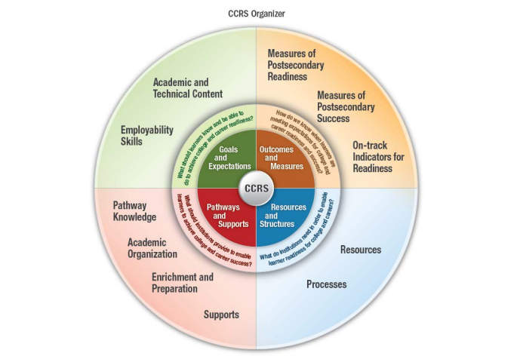
CCRS Organizer
Visual, consolidated overview of the many elements that impact a student’s ability to succeed in college and careers
Key content:
  Outcomes and Measures
  Resources and Structures
  Pathways and Supports
  Goals and Expectations
http://www.ccrscenter.org/ccrs-landscape/ccrs-organizer
60

Slide 67
Wrap-Up and Next Steps
61

Slide 68
Feedback and Thank You
Complete the postevent survey to provide valuable insight into revisions and finalization of the module.
Feel free to write any additional feedback to help improve the module.
62

Slide 69
References
Collaborative for Academic, Social, and Emotional Learning (CASEL). (n.d.). What is SEL?. Retrieved from https://casel.org/what-is-sel/.
Hart Research Associates. (2015). Falling short? College learning and career success: Selected findings from online surveys of employers and college students. Washington, DC: Hart Research Associates for the American Association of Colleges and Universities. Retrieved from https://www.aacu.org/sites/default/files/files/LEAP/2015employerstudentsurvey.pdf
Indiana Department of Education. (2019). Grade Six–Grade Eight Employability Skills Standards. Indianapolis, IN: Author. Retrieved from https://www.doe.in.gov/sites/default/files/wf-stem/grade-six-grade-eight-employability-skills-standards-final.pdf
Kansas State Department of Education. (2018). Measuring and reflecting student learning. Work-based experience portfolio and employability skills rubric. Topeka, KS: Author. Retrieved from https://www.ksde.org/Portals/0/CSAS/CSAS%20Home/CTE%20Home/Measuring%20and%20Reflecting%20Student%20Learning%20%28002%29.pdf
Lippman, L. H., Ryberg, R., Carney, R., & Moore, K. A. (Child Trends). (2015). Workforce Connections: Key “soft skills” that foster youth workforce success: Toward a consensus across fields. Bethesda, MD: Child Trends. Retrieved from http://www.childtrends.org/wp-content/uploads/2015/06/2015-24WFCSoftSkills1.pdf
Manpower Group. (2012). 2012 Talent Shortage Survey research results. Milwaukee, WI: Author. Retrieved from http://www.manpowergroup.us/campaigns/talent-shortage-2012/pdf/2012_talent_shortage_survey_results_us_finalfinal.pdf
63

Slide 70
Presenter’s Name
XXX-XXX-XXXX
xxxxxxxxxxx@air.org
College and Career Readiness and Success Center
1000 Thomas Jefferson Street NW
Washington, DC 20007
800-634-0503
www.ccrscenter.org | ccrscenter@air.org
64

