Slide 1

What are employability skills?
Skills desired by employers (in addition to technical skills)
Interpersonal Skills and Teamwork
Communication
Integrity and Professionalism
Problem Solving and Decision Making
Initiative and Dependability
Information Processing
Adaptability and Lifelong Learning
Entrepreneurship
http://prezi.com/ur8tlfkdxwaq/employability-skills-assignment/

Slide 2
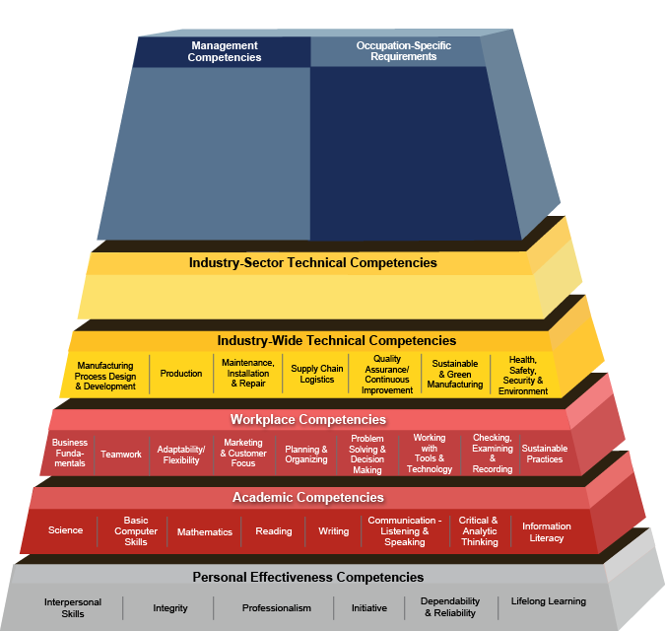


USDOL ETA
Competency Model
Clearinghouse
Advanced Manufacturing Competency Model
Notes:
Frank

Slide 3
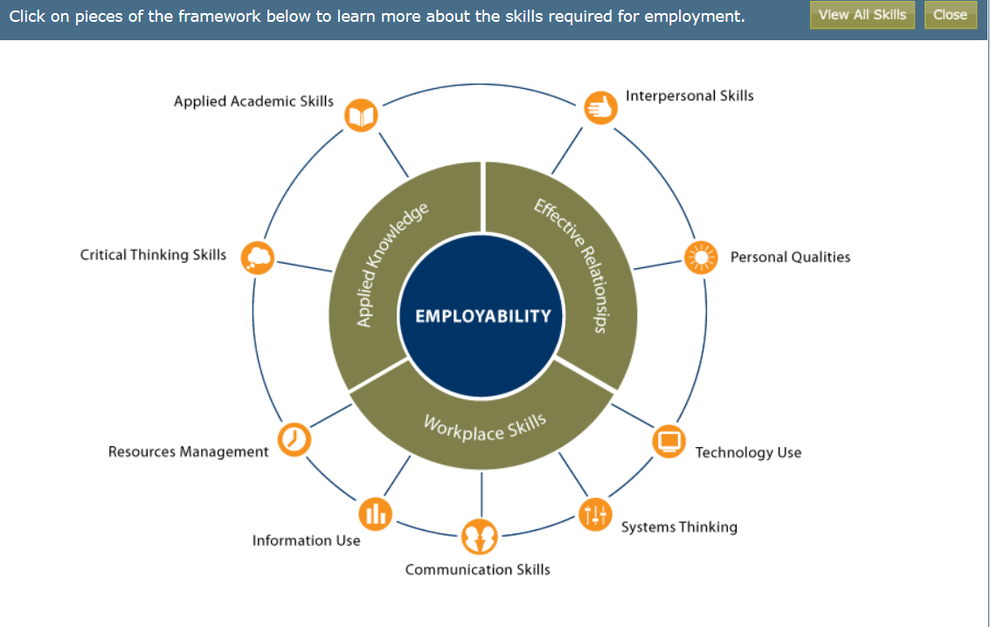
U.S. Department of Education
http://cte.ed.gov/employabilityskills/
Notes:
We jumped out with the U.S. DOE. Foundational skills. US DOL ETA Competency Models. Career Ready Practices. Workforce ready System.

Slide 4
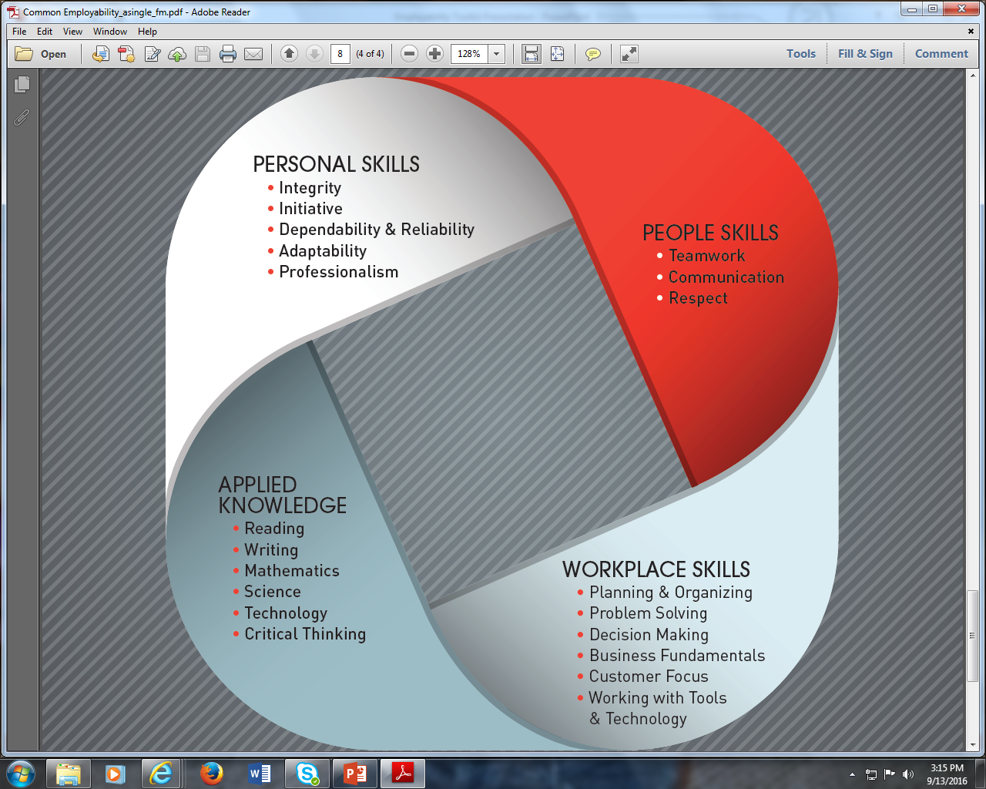
The Skills All Employees Need, No Matter Where They Work
National Network of Business and Industry Associations

Slide 5
From a state perspective
Over 1,000 employers were surveyed by the North Carolina Association of Workforce Development Boards; the resulting report, Closing the Gap: 2012 Skills Survey of North Carolina Employers, revealed:
  “The lack of basic communication skills has been a large obstacle.”
  “Employees who have an understanding of problem solving, team work, and continuous learning are very valuable.”
  “Attitude, enthusiasm, and appropriate attire are the key basics. Experience and education is next.”

Slide 6
Nationally
Job Outlook 2013 report, published by the National Association of Colleges and Employers
  “what makes a new graduate stand out from equally qualified competitors . . . is the evidence of the ‘soft skills’ needed in the workplace. Employers prize skills such as communication skills, the ability to work in a team, and problem-solving skills.”

Slide 7
Internationally
For the report 2012 Talent Shortage Survey, Manpower Group surveyed more than 38,000 employers in 41 countries
Eighteen percent noted that “soft” skills are where job candidates most often fall short
  Interpersonal skills
  Enthusiasm/motivation
  Collaboration/teamwork
  Professionalism
  Flexibility/adaptability
  Ability to deal with ambiguity/complexity
  Attention to detail
  Problem solving and decision making

Slide 8

NC-NET Responded by Creating
The North Carolina Network for Excellence in Teaching
A collaborative, statewide professional development system
Perkins funded
Approaching it’s 13th Anniversary
Developed by Center for Occupational Research and Development (CORD).
http://www.nc-net.info/employability.php
Notes:
Honesty Exam

Slide 9
Toolkit Purpose
Enable instructors/experts to integrate employability skills practice into courses/culture (HRD, WBL, EGR, Intro, etc.)
Helps instructors support student success
Technical
Academic
Employability

Slide 10
Assessments
Workforce Ready System (SkillsUSA)
  Employability Blueprint/Assessment
National Occupational Competency Testing Institute (NOCTI)
  Workplace Readiness
  21st Century Skills for Workplace Success
ACT WorkKeys
  Noncognitive Assessments (Fit, Performance, Talent)
Wisconsin’s Employability Skills Certificate Assessment
NCCER (Construction) Core Curriculum
Working Smart

Slide 11

Contact & Reference Information
References:
http://www.workforcereadysystem.org/assessments/assessment-areas/
http://www.nocti.org/BlueprintCategoryLinks.cfm?category=Employability Skills
http://www.workingsmartnc.com/
http://www.act.org/content/act/en/products-and-services/workforce-solutions/act-workkeys/about-act-workkeys.html
http://cte.ed.gov/employabilityskills/
http://www.careeronestop.org/CompetencyModel/competency-models/pyramid-home.aspx
http://www.nber.org/papers/w21473
http://dpi.wi.gov/cte/skills-standards/employability
http://www.jff.org/sites/default/files/publications/WorkReadiness.pdf
Contact Info:
Frank Scuiletti
NCCCS Program Coordinator, Engineering & Technology, Worked-Based Learning
scuilettif@nccommunitycolleges.edu

