Slide 1

Choosing A College
Understanding Education Preparation Programs

Slide 2
Conditions in The Articulation Agreement?
Admission is not assured to a specific campus or specific program or major
Student must have graduated from NC CC with an AAS in Early Childhood Education
Student must meet minimum GPA and/or Praxis score admission requirements for four-year institution's Bachelor's Degree in B-K and Early Education related degrees
Student must have a grade of "C" or better for all Early Childhood AA courses
Student must be academically eligible for readmission to the last institution attended
Student must meet judicial requirements of the institution that you apply
Students must meet all application requirements at the receiving institution, including the submission of all required documentation by stated deadlines.

Slide 3
Who Does this agreement apply to?
All students from any one of the 58 North Carolina Community College Early Childhood Education Programs who meet the conditions stated in slide #1.
Graduates of the A55220 Program in the NC CC

Slide 4
What Schools can be considered for transfer?
Appalachian State University
East Carolina University
Elizabeth City State University
Fayetteville State University
NC Agricultural and Technical State University
NC Central University
UNC at Charlotte
UNC at Greensboro
UNC at Pembroke
UNC Wilmington
Western Carolina University
Winston-Salem State University

Slide 5
Are there any Early Childhood Non-teaching licensure Options?
1.East Carolina University: Family and Community Services, Child Development Concentration
2. Elizabeth City State University: Child, Family and Community
3. Fayetteville State University: Birth-Kindergarten Non-Teaching
4. North Carolina Agricultural and Technical University: Child Development and Family Studies
5. North Carolina Central University: Family Consumer Sciences, Child Development and Family Relations Concentration
6. University of North Carolina Greensboro: Early Care and Education
7. Western Carolina University: Early Childhood
8. Winston-Salem State University: Early Intervention and Preschool Concentration or Business Optional Concentration

Slide 6
Transfer Resources
Partnerships may be:
Statewide transfer agreements
2+2 programs for Associate in Applied Science program graduates (2 years at Wake Tech or another community college and 2 years at the university)
A specific transfer opportunity offered to Wake Tech graduates
Prospective students should always contact the transfer admissions office of the colleges and universities they are interested in to ensure that they have the most up-to-date information on transfer requirements and opportunities.

Slide 7
NC Community College Transfer
7 General Suggestions to keep in mind when transferring to the UNC System from a NC Community College:
Review the Comprehensive Articulation Agreement (CAA), a statewide agreement governing the transfer of credits between NC community colleges and the UNC System. The transfer course list explains which NC community college courses will be eligible to count as credits at all 16 universities in the UNC System.
Review the admission requirements at the individual institutions you are considering; each institution’s requirements will vary.
Review partnerships between individual community colleges and UNC System institutions. In some cases, formal agreements have been established in order to facilitate transfer student success.
Choose a baccalaureate degree plan using the links below. Finding and following an approved degree plan will help you plot your pathway toward graduation with efficiency. This will save you time and money. Mapping out a pathway in advance will help you focus on community college courses that will fulfill the prerequisites for the upper-level courses you’ll need at the university.
Review transfer course equivalencies at the institution you are transferring to (links provided below). Even if you did not complete an associate degree, many of the courses you completed at the community college level will count toward your four-year degree.
Fill out a free application for Federal Student Aid (FAFSA) and visit the Financial Aid office on the campus of your choice.
If your NC Community College Advisor needs assistance, please have them access the Transfer Toolbox for additional resources

Slide 8
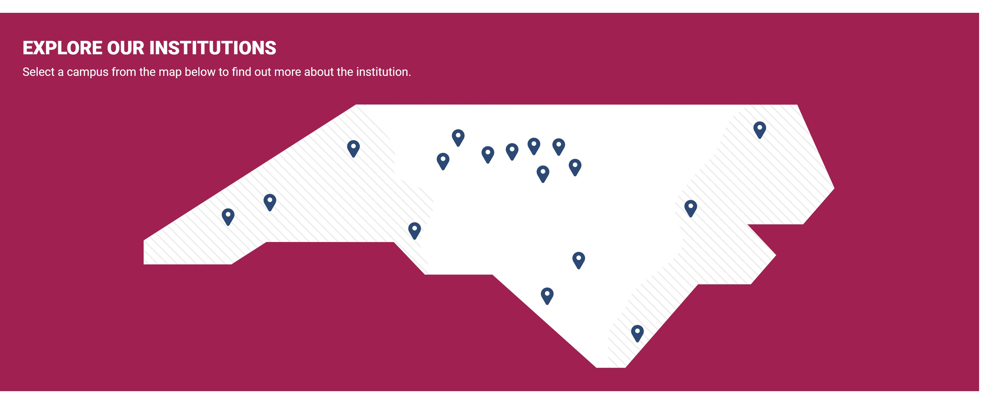
Institutions and Affiliates
Click above on the title and you will be taken to the colleges that you wish to explore.
It's time to visit some schools and learn some more.
Virtual tour time for you to see what the college has to offer in your area of study and more.
So, like I said, time for a tour...

Slide 9
Take Note of these Answers as you Explore and perhaps you may answer even a few more...
As always, a task you will complete.. A fact-finding mission is one that will be neat.
As you visit the schools in your virtual visits, keep notes to be used in our writing task to follow.
Perhaps by the end you will make a decision and project the next steps to take in this journey.
Ah, yes that journey we learned about last week, now you will see this is not for the weak.....

Slide 10
Colleges I Visited Virtually
Name:
Location:
Name:
Location
20 Question Responses
20 Question Responses

Slide 11
Colleges Visited Virtually
Name
Location
Name:
Location:

